Slide 1

Data Handling and Visualization Project
"Welcome to a world of data-driven insights. Let's embark on a journey to unveil the hidden stories within the numbers and bring your data to life through visualization."

Slide 2
CRICKET:
Welcome to the greatest game of all – Cricket.

Slide 3
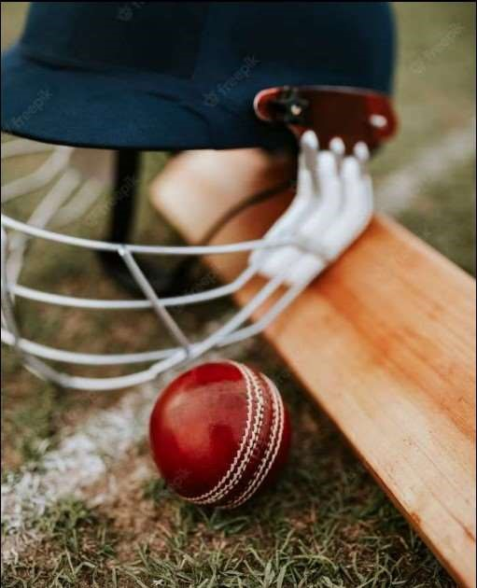
Cricket is immensely popular with dedicated fans worldwide. Fans enthusiastically support both local and national teams. The sport's popularity continues to grow steadily. Major tournaments like The Ashes, IPL League, and ICC Cricket World Cup draw enormous attention and excitement.

Slide 4
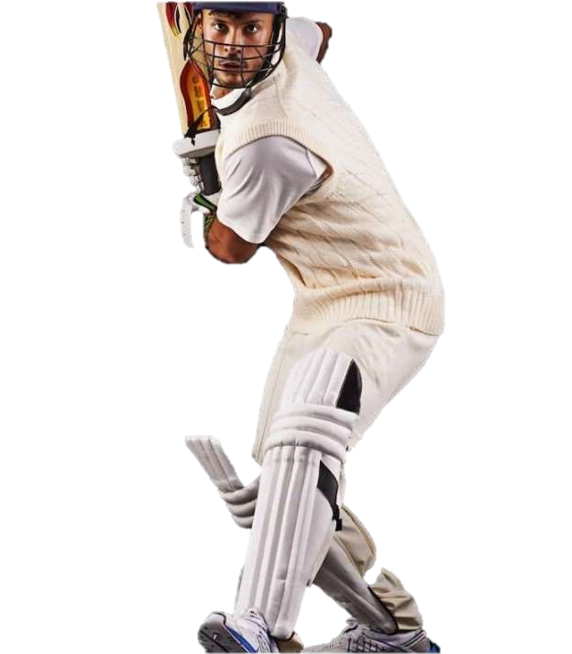
Cricket is played between two teams of eleven players. The game takes place on a field with a 22-yard pitch at the center . Each end of the pitch has a wicket, consisting of two bails on three stumps. The batting team scores runs by hitting the ball and running between the wickets. The bowling and fielding team aims to prevent runs and dismiss batters. Batters can be declared "out" in various ways, such as getting bowled or caught.
What Are the Basic Rules and Objectives of Cricket?

Slide 5
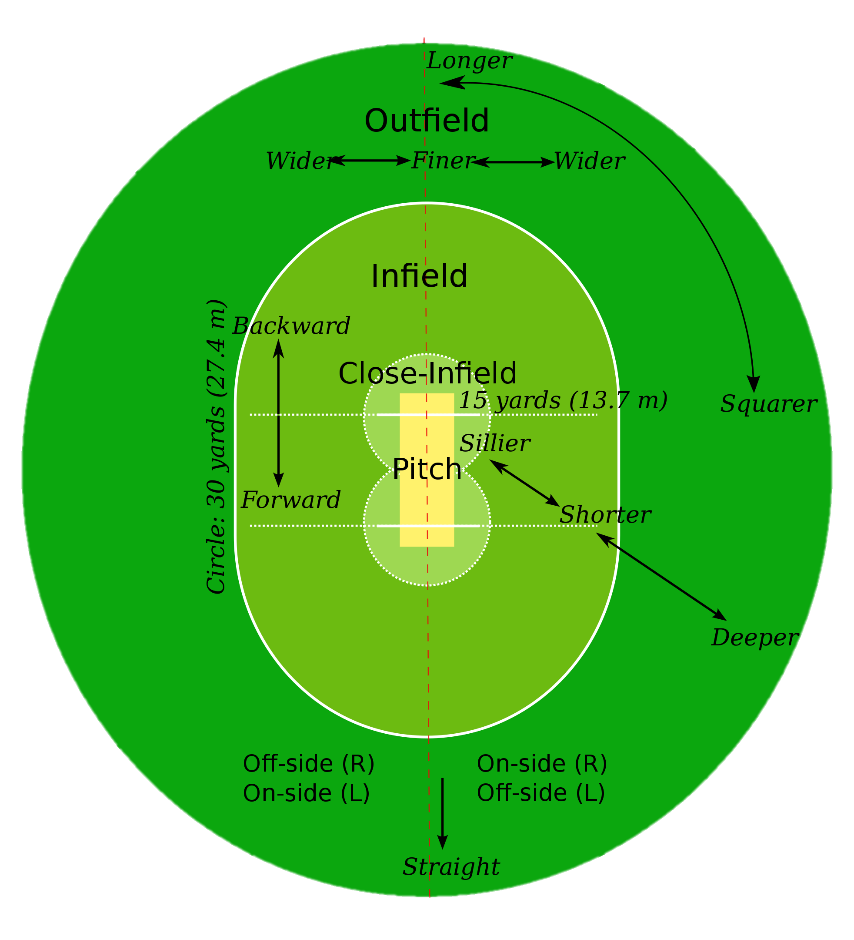
Dismissal methods include being bowled (ball hitting stumps), caught, or run out. Innings end after ten dismissals; teams swap roles - batting to fielding. Each over consists of six balls bowled by the same bowler. Game overseen by two on-field umpires; supported by a third umpire and match referee in internationals.

Slide 6
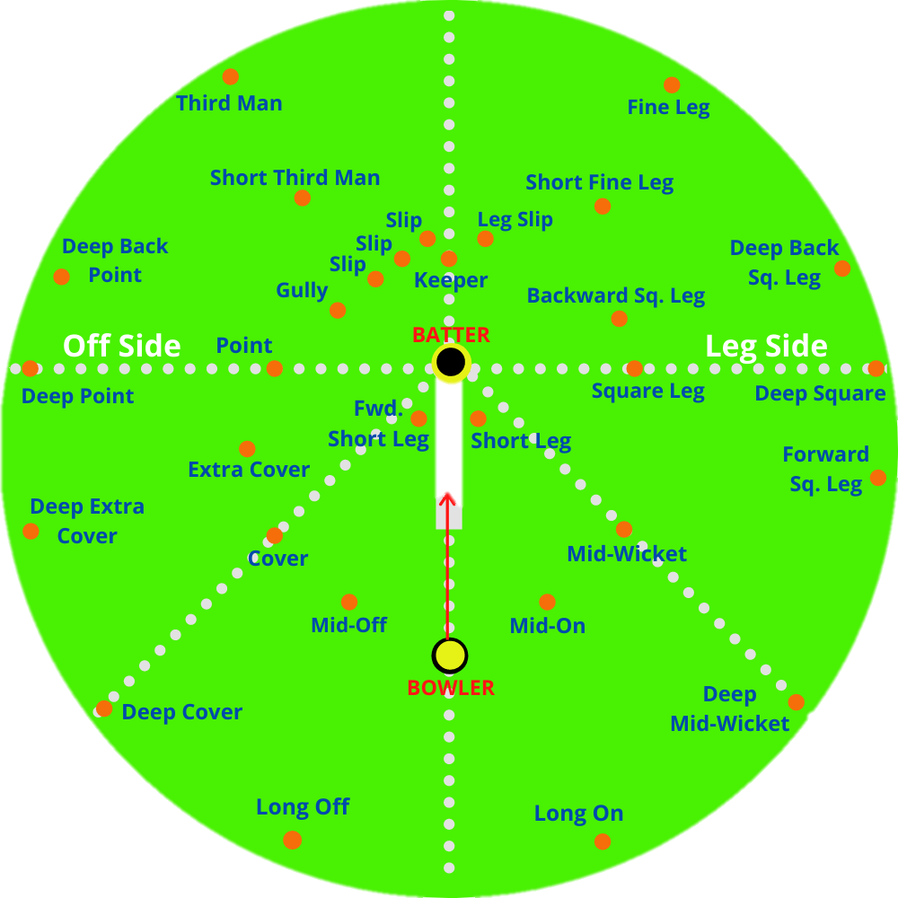
Cricket formats vary from Twenty20 (T20) with 20 overs per team, lasting 3-4 hours, to Test matches played over five days. Each "over" consists of 6 opportunities for the batting team to score. Traditional attire includes all-white kit, but limited overs cricket allows club or team-coloured uniforms.

Slide 7
Link Of Website having all rules of Cricket
https://icc-laws-of-cricket-ayush-harsh.netlify.app/

Slide 8
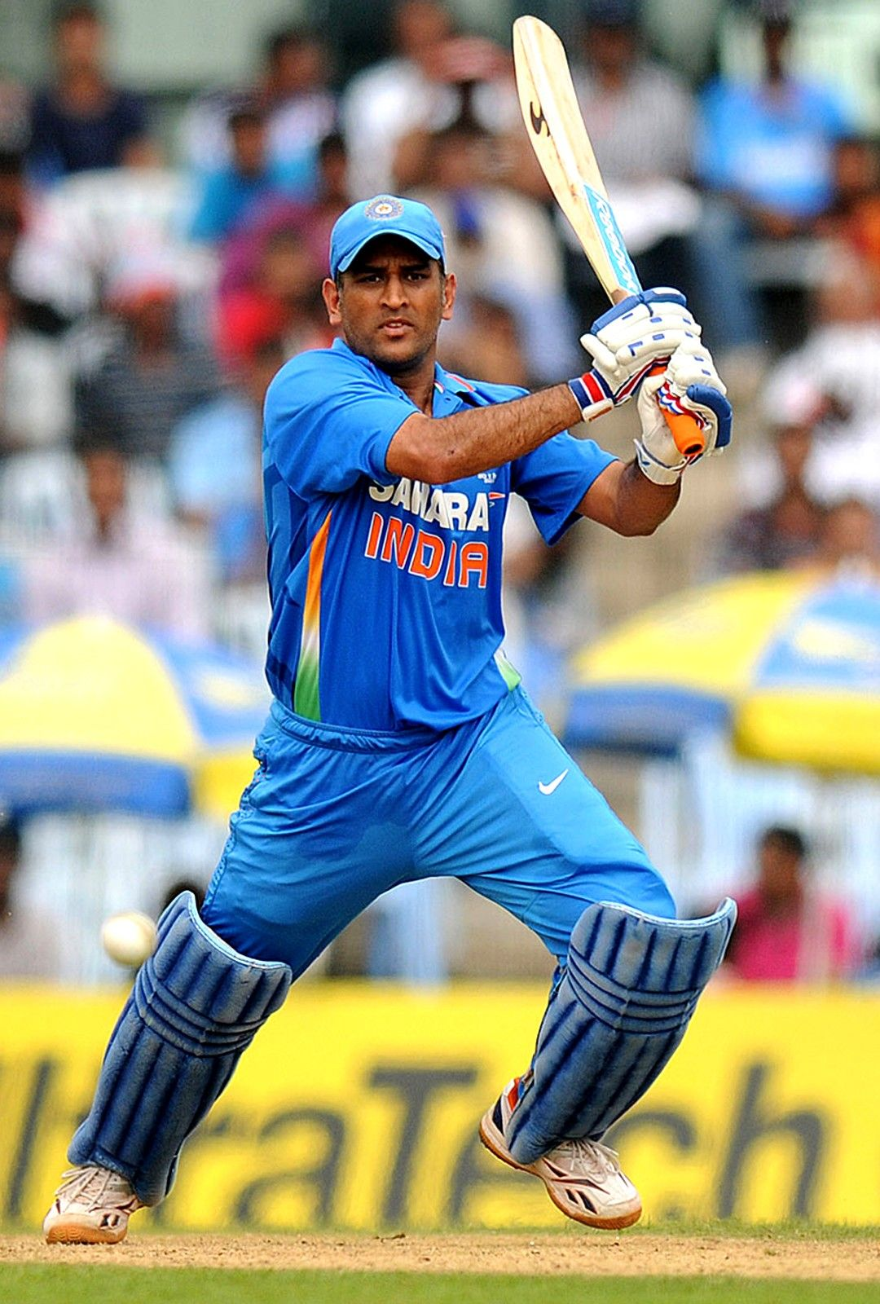
Batsmen score runs by running to each other's end of the pitch, earning one run per completed run. They can also score runs by hitting boundaries: a ball past the boundary after hitting the ground earns 4 runs, and on the full earns 6 runs. .
Ways to Score Runs

Slide 9
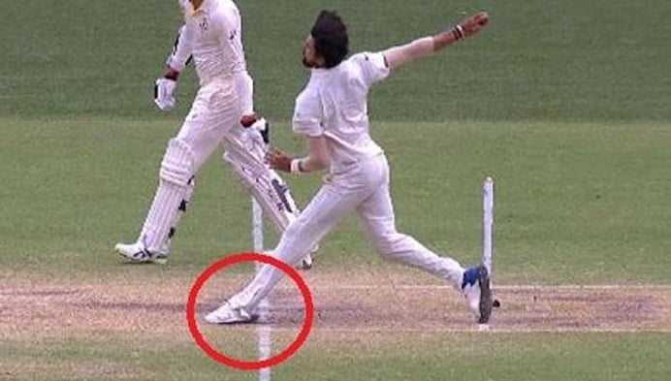
"No Ball" can be declared for various reasons: wrong bowling place, dangerous delivery (especially aimed at batsman's body), bouncing more than twice, rolling before reaching batsman, or illegal fielding positions.

Slide 10
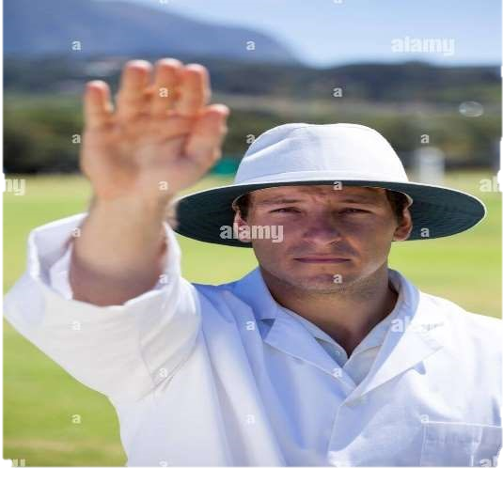
"Wide Ball" is declared if batsman can't reasonably score; if over head height, it's a no ball. "Bye" scores runs without bat contact. "Leg Bye" scores runs by hitting batsman but not bat, provided batsman attempted a shot; no runs if avoiding ball.

Slide 11
HISTORY

Slide 12
Cricket is part of the "club ball" games, like baseball, golf, hockey, tennis, squash, badminton, and table tennis. Cricket is unique due to the presence of a solid target structure called the wicket. Players aim the ball at the wicket and defend it, distinguishing it from other club ball games. Historically, cricket's origins are linked to herding practices involving wicket gates. The cricket historian Harry Altham categorized club ball games into three groups: hockey, golf, and cricket, based on their target structures and gameplay.
HISTORY

Slide 13
Women's cricket

Slide 14
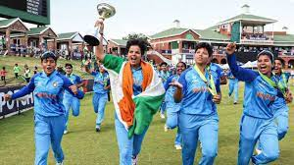
Women's cricket
Women's cricket originated in Surrey in 1745.
First women's Test Match: Australia vs England in December 1934.
New Zealand joined in the following year, and Netherlands became the tenth women's Test nation in 2007.
International Women's Cricket Council founded in 1958, merged with ICC in 2005.
First Women's Cricket World Cup held in England in 1973.
ICC Women's Rankings launched on 1 October 2015, covering all three formats.
In October 2018, Women's rankings split into separate ODI and T20I lists.

Slide 15
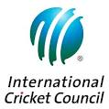
Governance The International Cricket Council (ICC),is the global governing body of cricket.
Currently has 105 member nations, including twelve with full membership for Test cricket.
Responsible for organizing major international tournaments like the Cricket World Cup for men and women.
Appoints umpires and referees for sanctioned Test matches, Limited Overs Internationals, and Twenty20 Internationals.
Each member nation has its national cricket board, regulating matches, selecting national squads, and organizing tours.

Slide 16
Nation | Governing body | Full Member since
Afghanistan | Afghanistan Cricket Board | 22 June 2017
Australia | Cricket Australia | 15 July 1909
Bangladesh | Bangladesh Cricket Board | 26 June 2000
England | England and Wales Cricket Board | 15 July 1909
India | Board of Control for Cricket in India | 31 May 1926
Ireland | Cricket Ireland | 22 June 2017
New Zealand | New Zealand Cricket | 31 May 1926
Pakistan | Pakistan Cricket Board | 28 July 1952
South Africa | Cricket South Africa | 15 July 1909
Sri Lanka | Sri Lanka Cricket | 21 July 1981
West Indies | Cricket West Indies | 31 May 1926
Zimbabwe | Zimbabwe Cricket | 6 July 1992

Slide 17
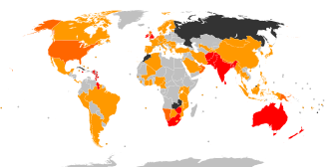
MAP VISULIZATION ABOVE DATA
ICC member nations. The (highest level) Test playing nations are shown in red; the associate member nations are shown in orange, with those with ODI status in a darker shade; suspended or former members are shown in dark grey.

Slide 18
ICC survey reveals over a billion fans - 90% in subcontinent
952 million fans estimated in 14 surveyed countries, plus 87 million outside, with 90% from the subcontinent.
87% of fans desire cricket in the Olympics.
68% interested in women's cricket, 65% in Women's World Cup, and 70% want more live coverage of women's cricket.
Nearly 70% of the 16-69 age group sample interested in Test cricket, indicating its continued popularity.

Slide 19
Competitions
Cricket played internationally and domestically.
Major international championship for each format.
Top domestic competitions reflect main international formats.
T20 leagues popular, leading to "T20 freelancer" trend.
International matches organized as tours, spanning weeks or months.

Slide 20
Data Collection
Data Cleaning
Data Analysis
Data Visualization

Slide 21
Data Collection
Collecting accurate cricket data from various sources and formats.
Like-ESPN cricinfo,Cricmetric,Kaggle,Wikipedia ,etc.

Slide 22
Data Cleaning
Removing errors, inconsistencies, and outliers from the collected data.

Slide 23
CODES

Slide 24
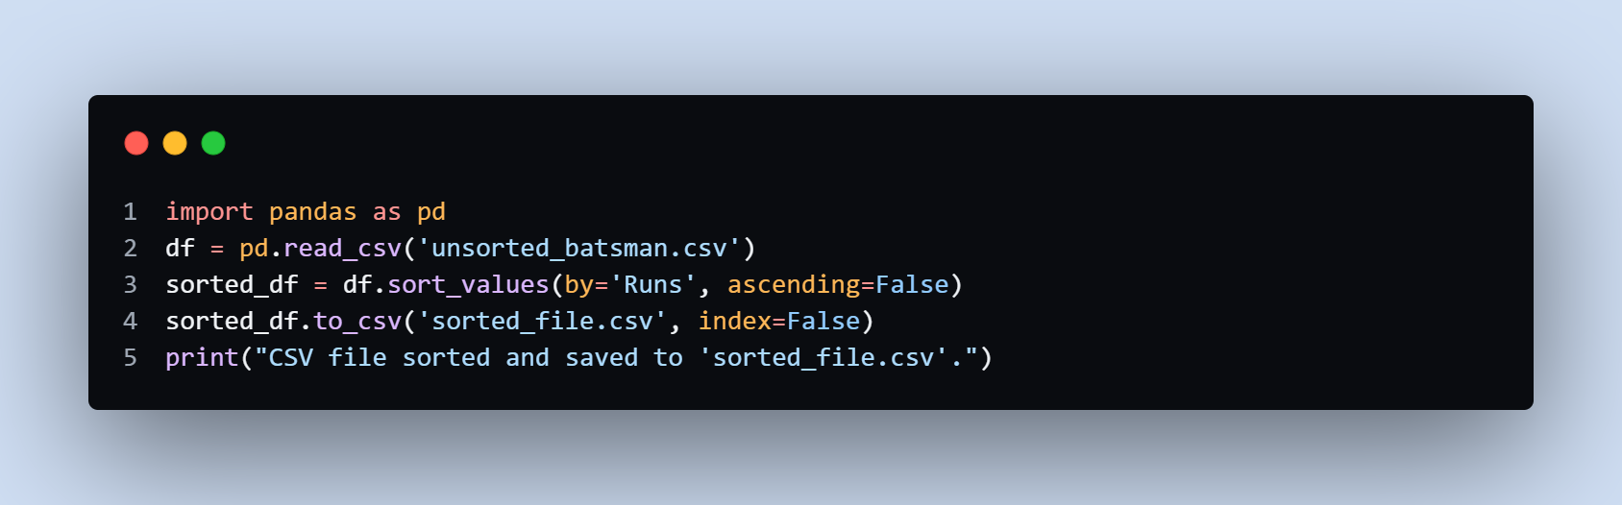
Sorting by runs (Top 100 batsman)

Slide 25
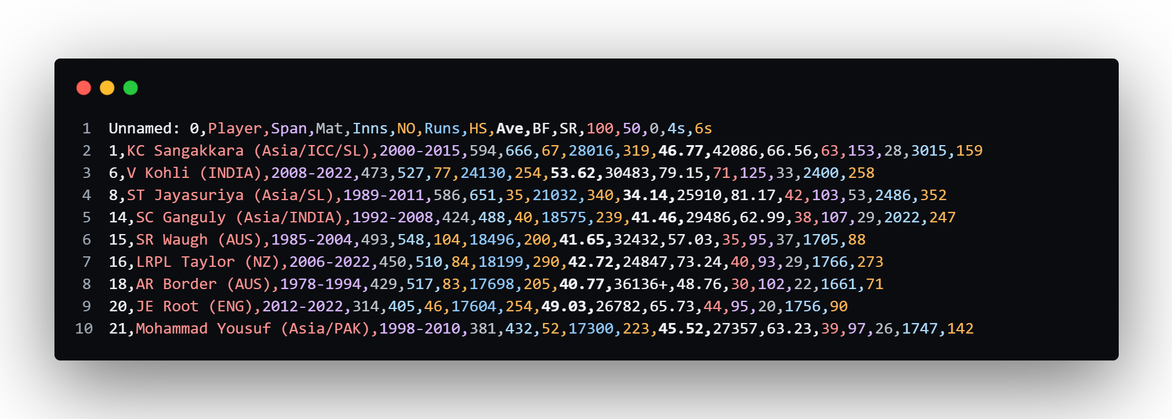
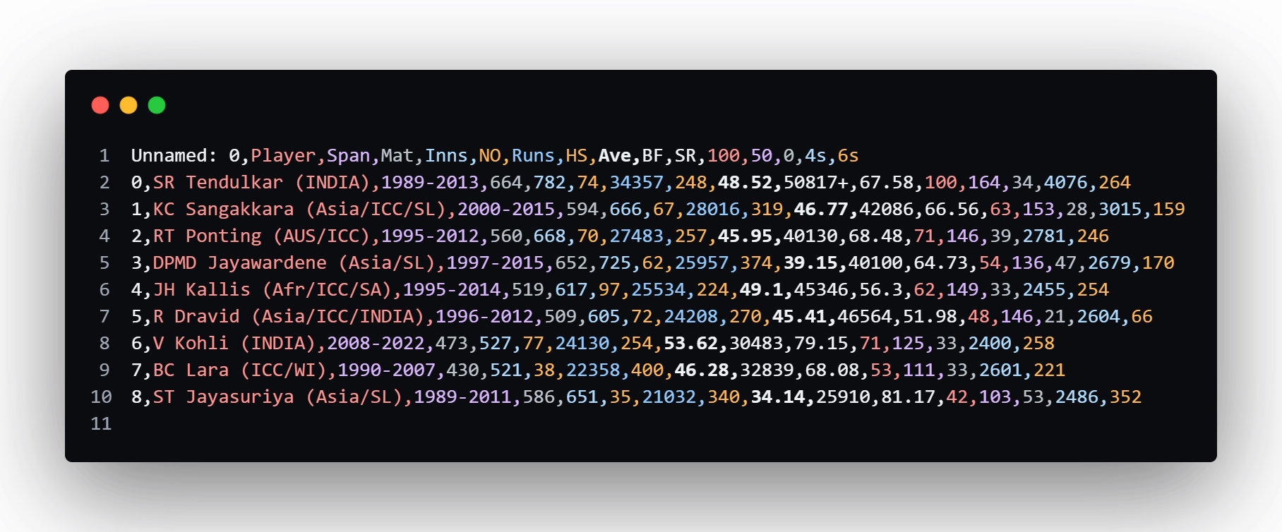

Slide 26
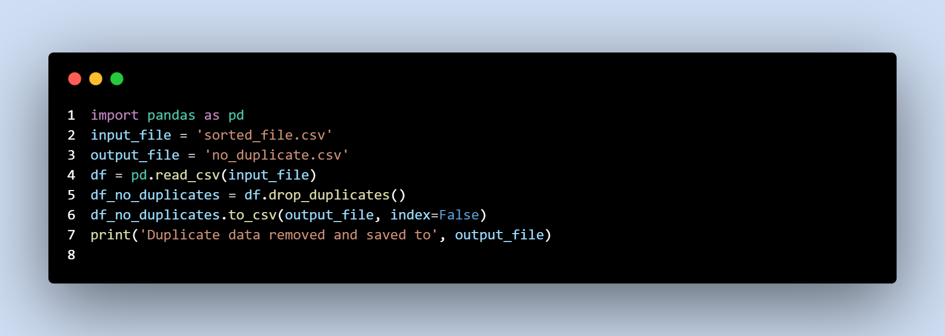
Remove Duplicates

Slide 27
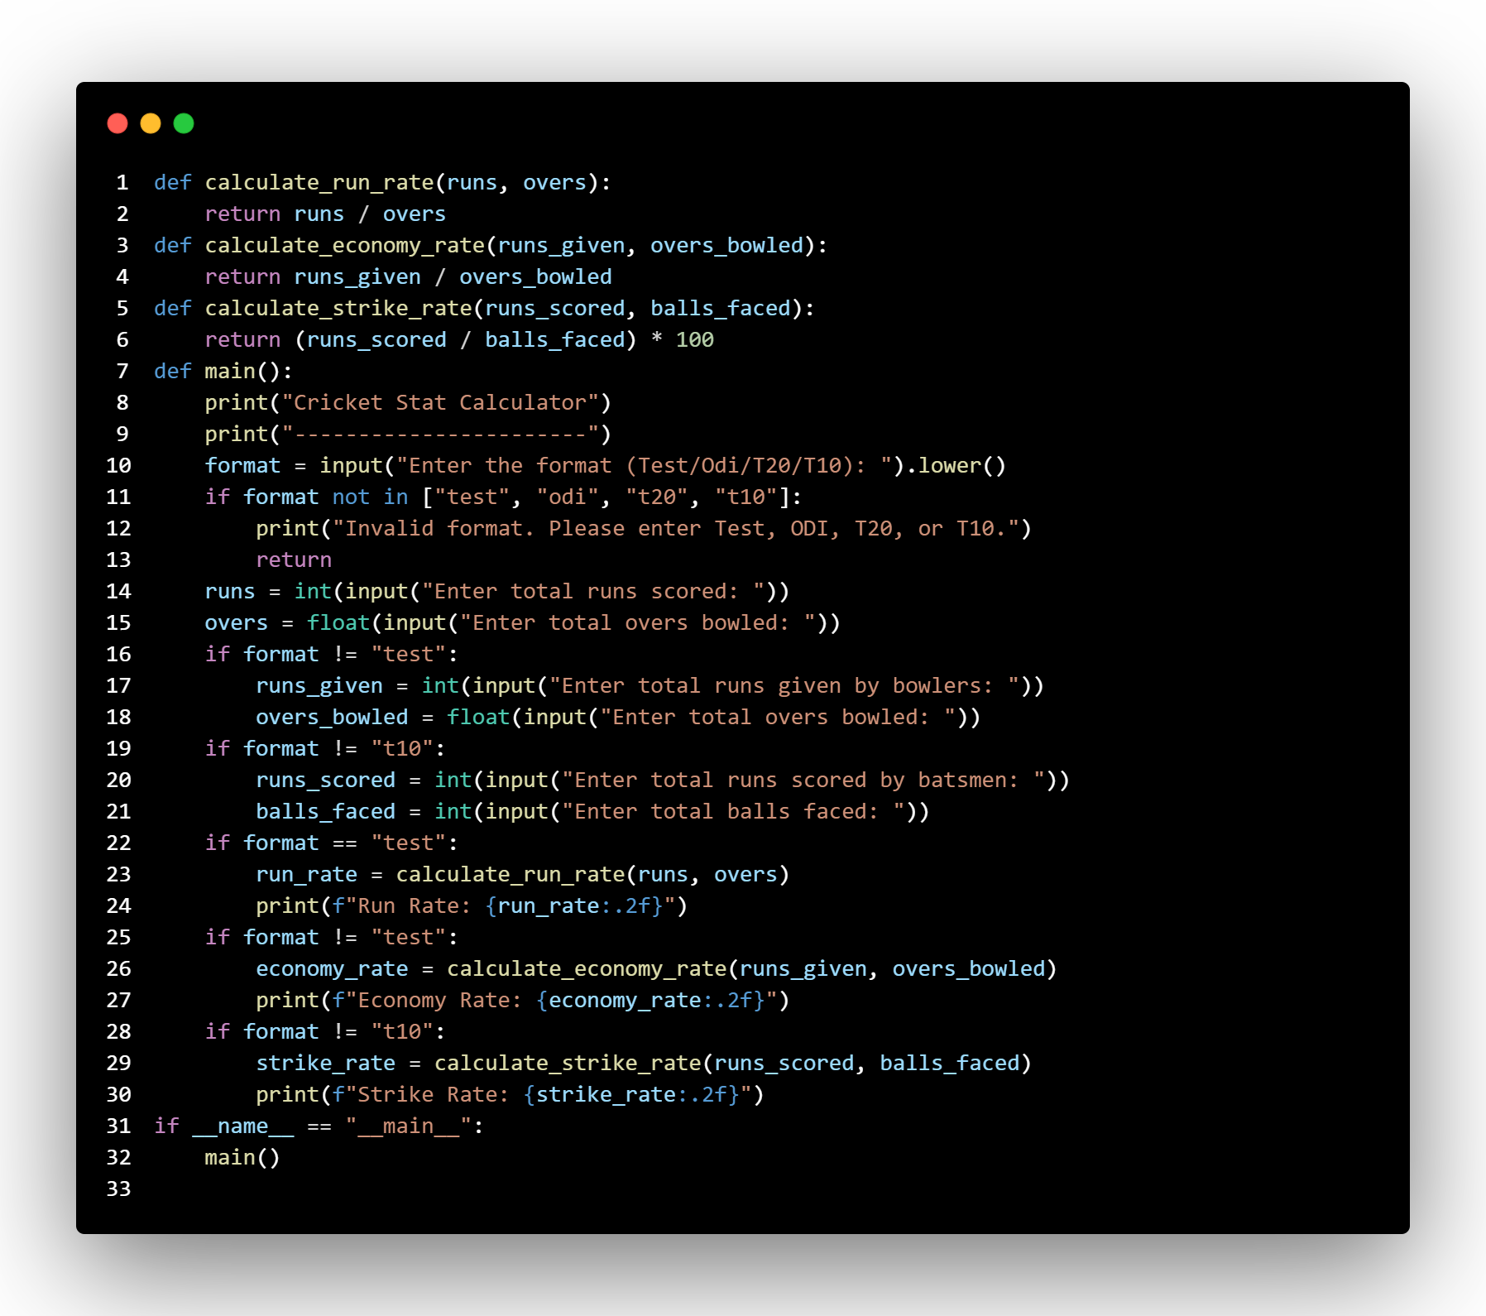
"Cricket Stat Calculator"

Slide 28
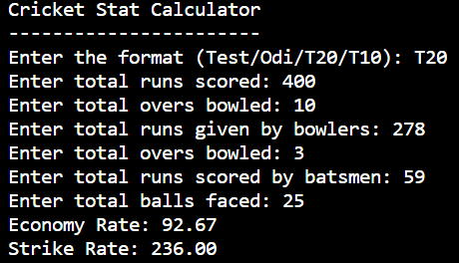
Output

Slide 29
Stats Calculating Website
https://statscalculator-ayush-harsh.netlify.app/

Slide 30
Data Analysis
Performing statistical analysis and identifying patterns and trends in the cricket data.

Slide 31
Data Visualization
Presenting the analyzed cricket data through engaging and informative visualizations.

Slide 32
Bar Chart
Line Chart
Pie Chart
Histogram
Heatmap
Box Plot
Column Chart
Stacked Column Line Chart
Tree Map
Donut Chart
Etc.

Slide 33
Pie Chart

Slide 34
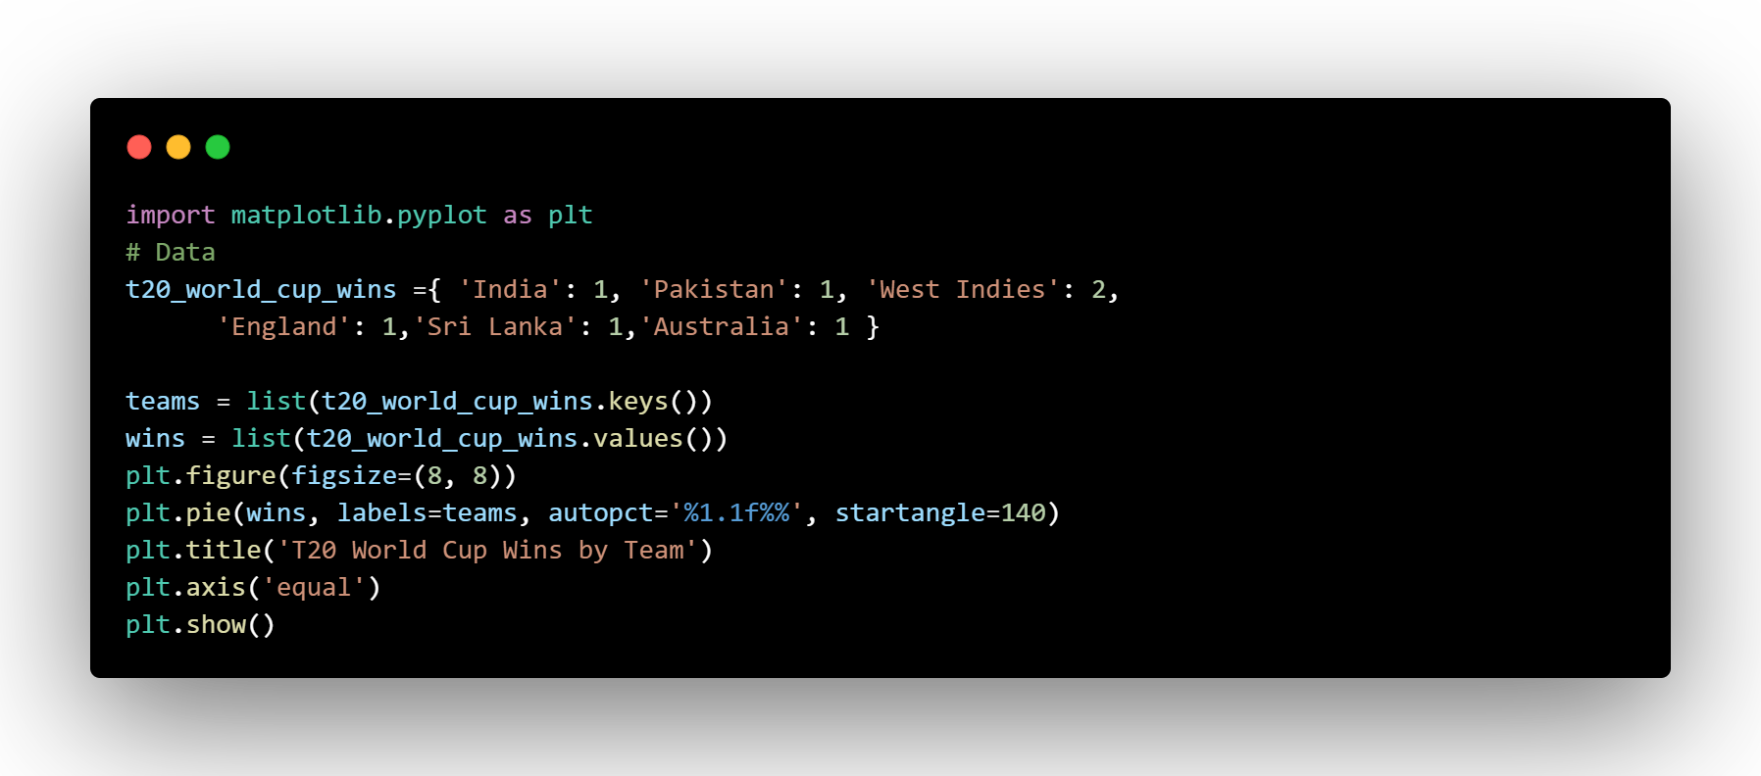
Using Pie chart The number of T20 World Cup wins by different cricket teams.

Slide 35
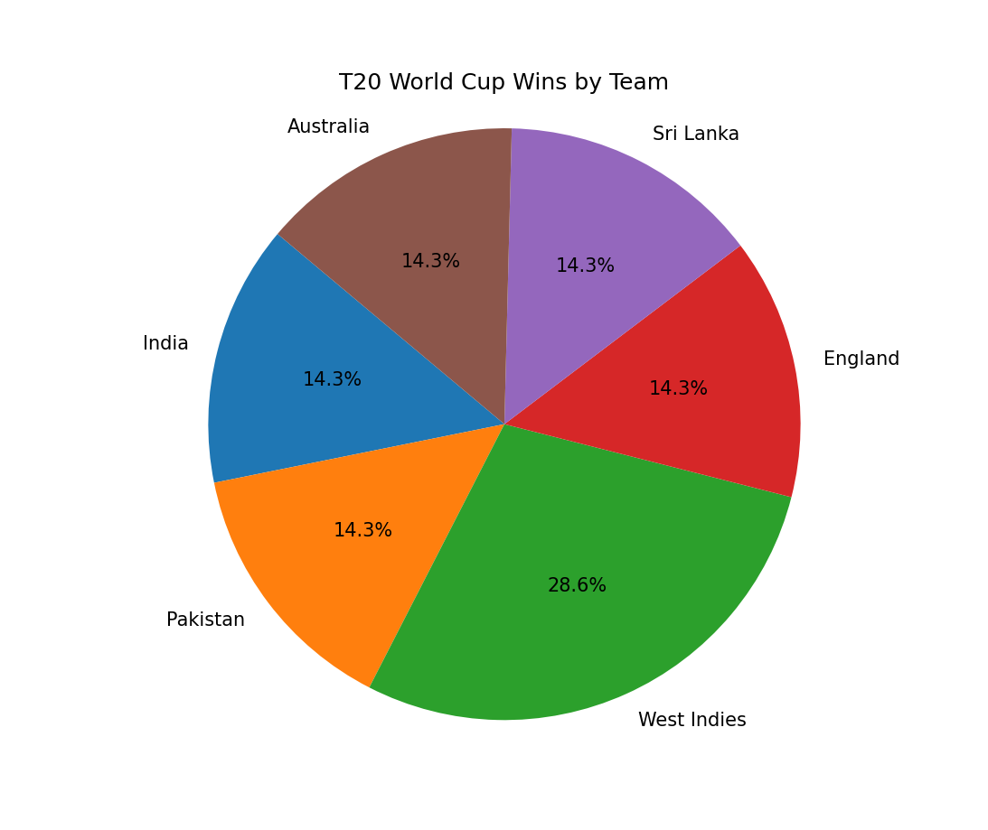

Slide 36
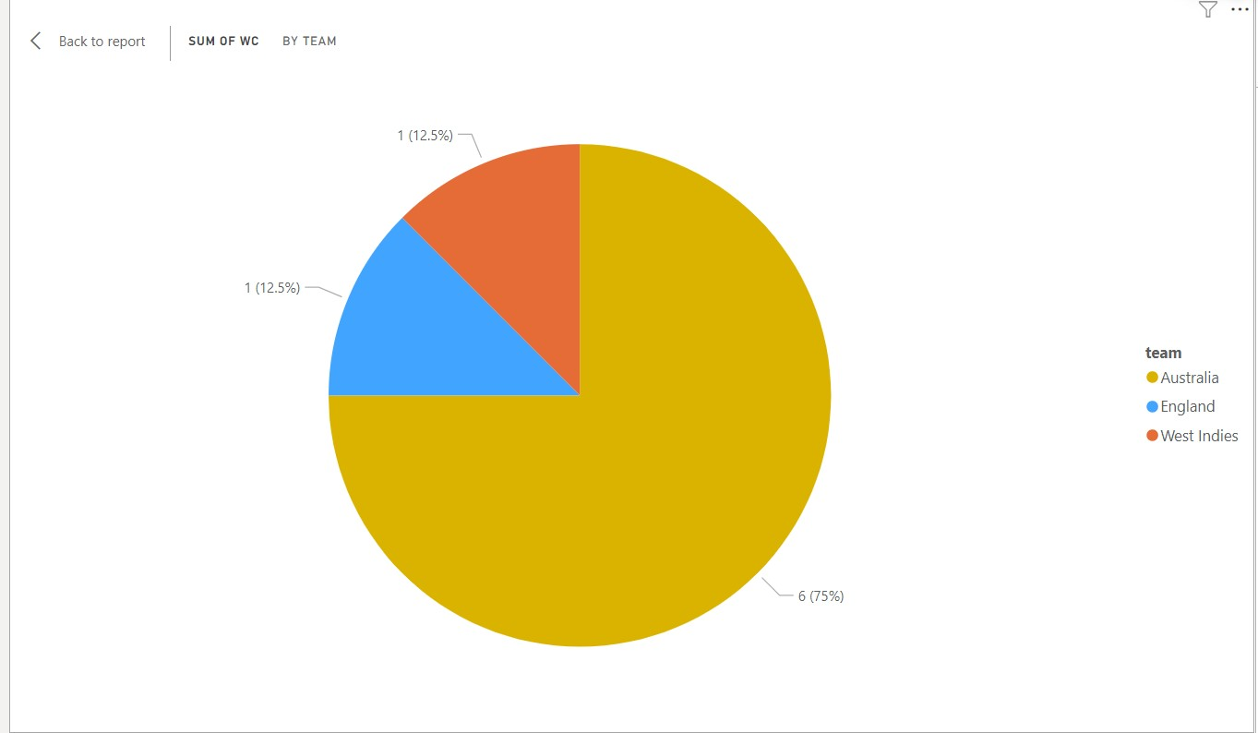
Women’s T20 World Cup Pie Chart

Slide 37
Line chart

Slide 38
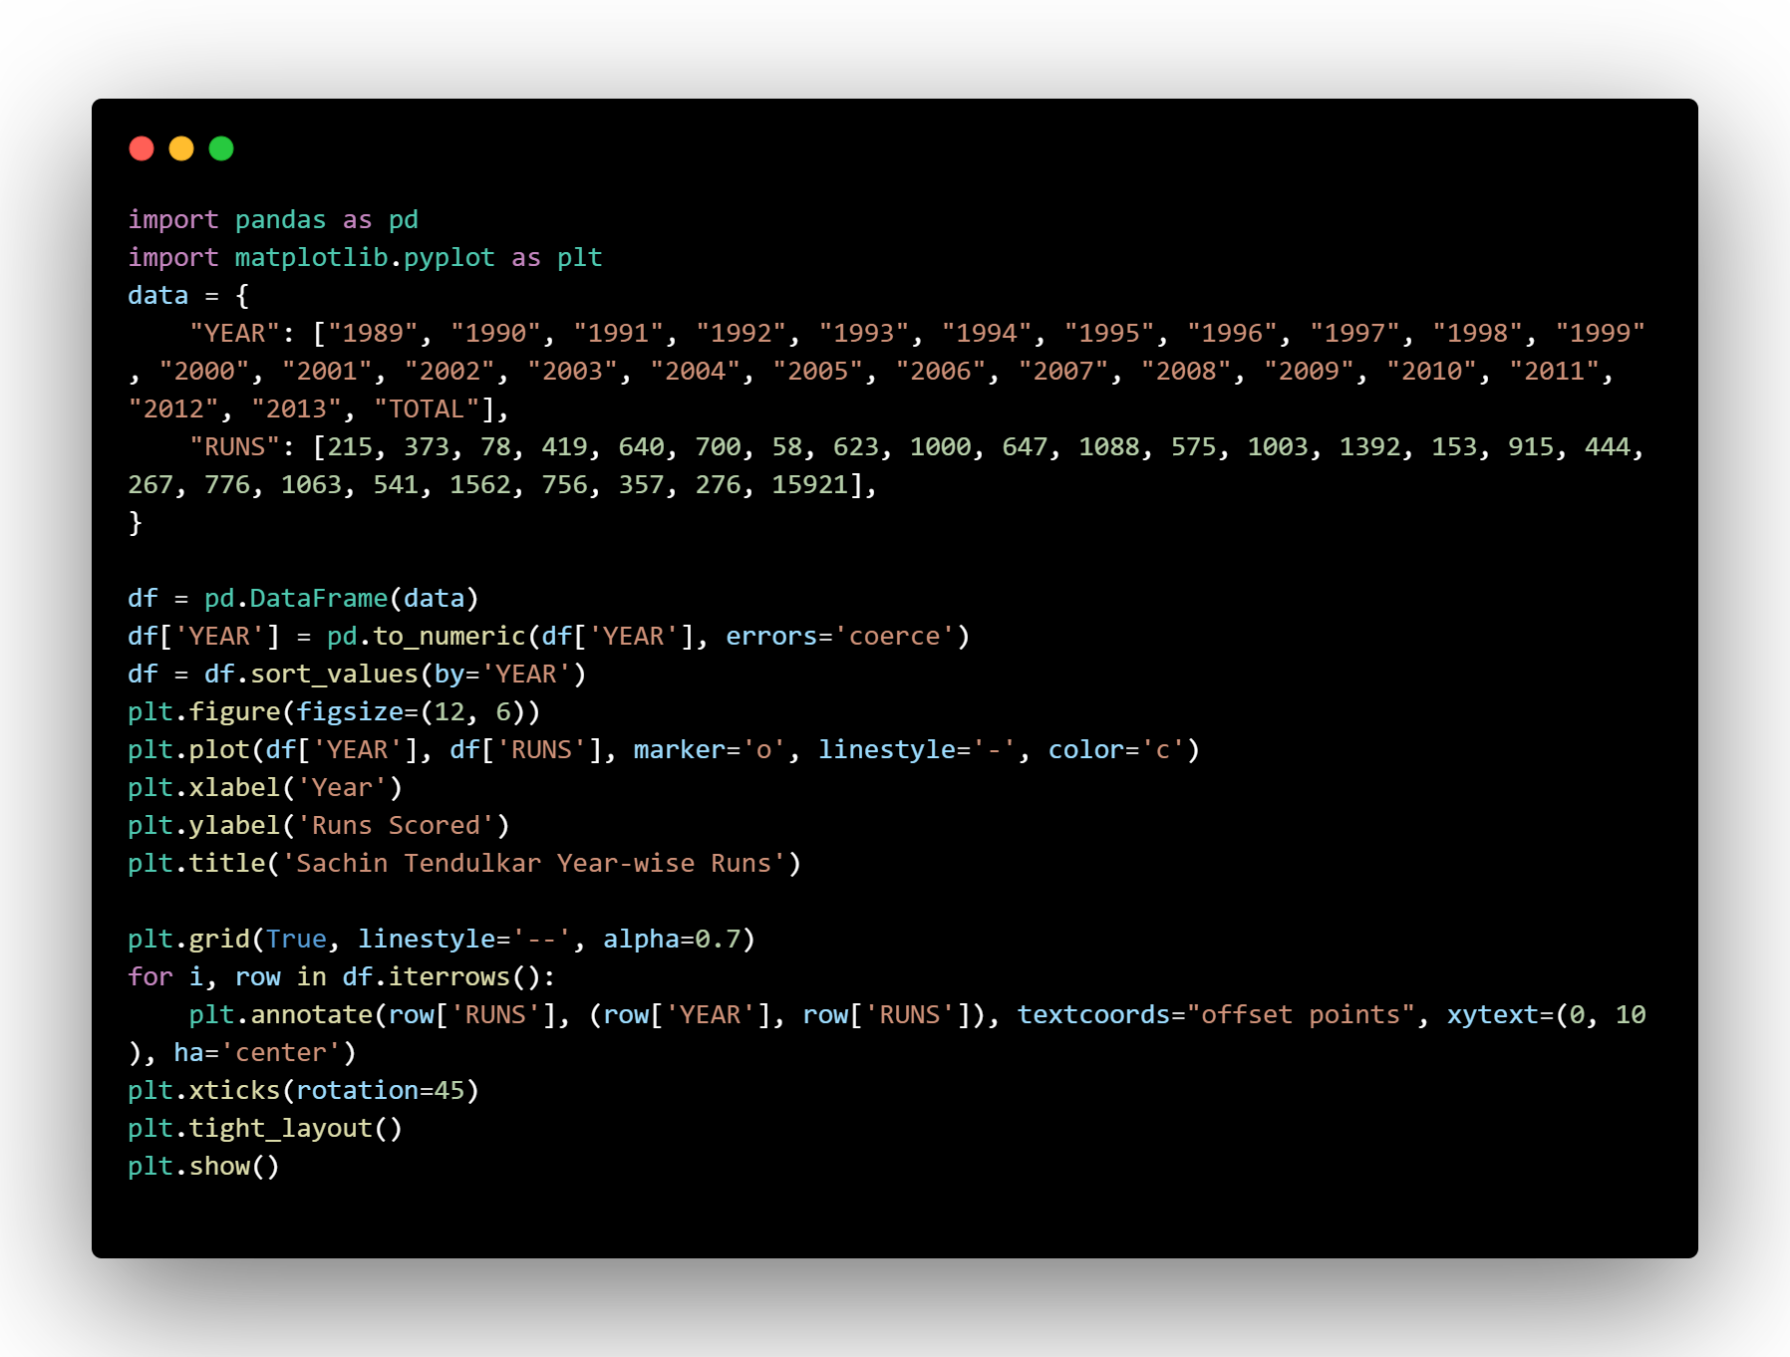
Using Line Graph visualize the year-wise runs scored by Sachin Tendulkar..

Slide 39
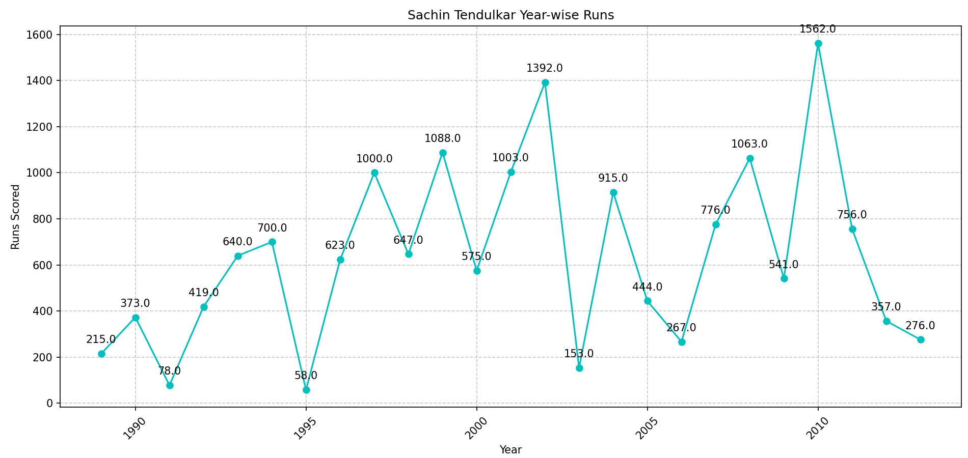

Slide 40
Bar Chart

Slide 41
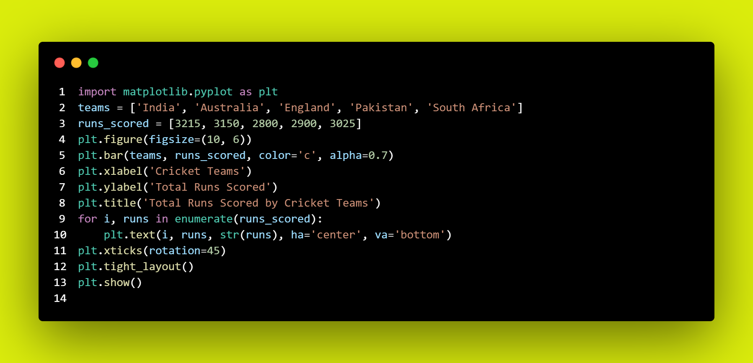
Using Bar chart visualize the total runs scored by different cricket teams.

Slide 42
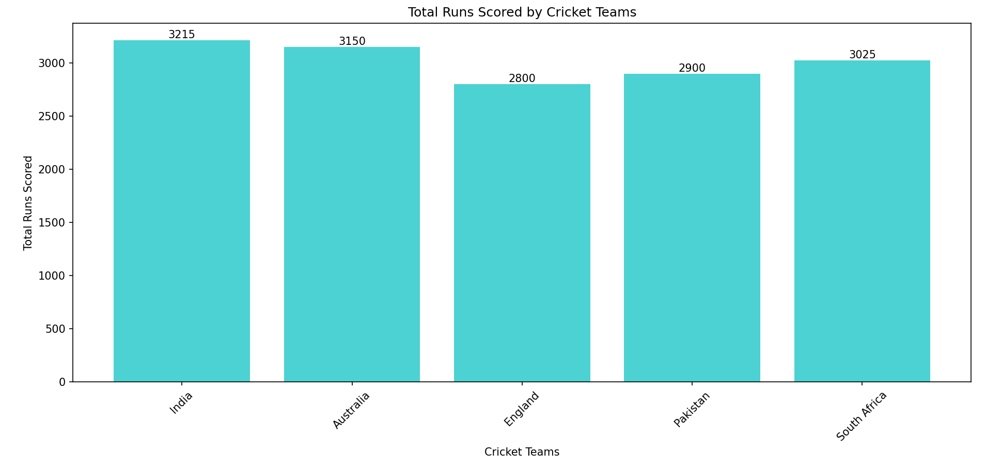

Slide 43
Histogram

Slide 44
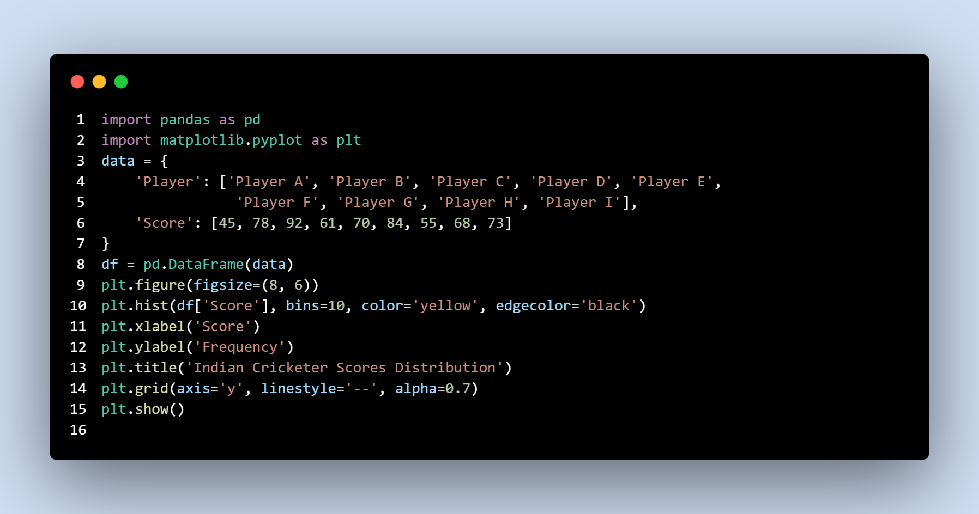
Using a Histogram to visualize cricketer scores

Slide 45
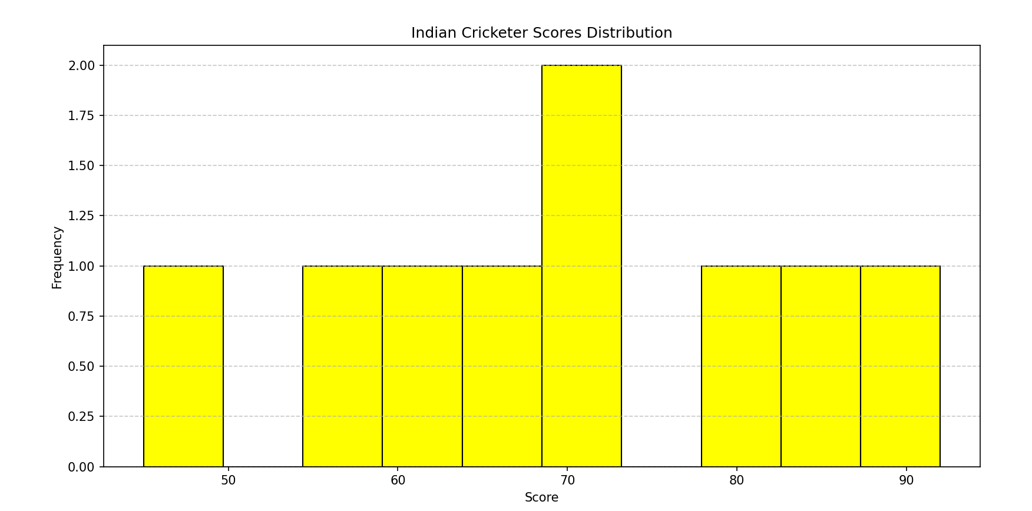

Slide 46
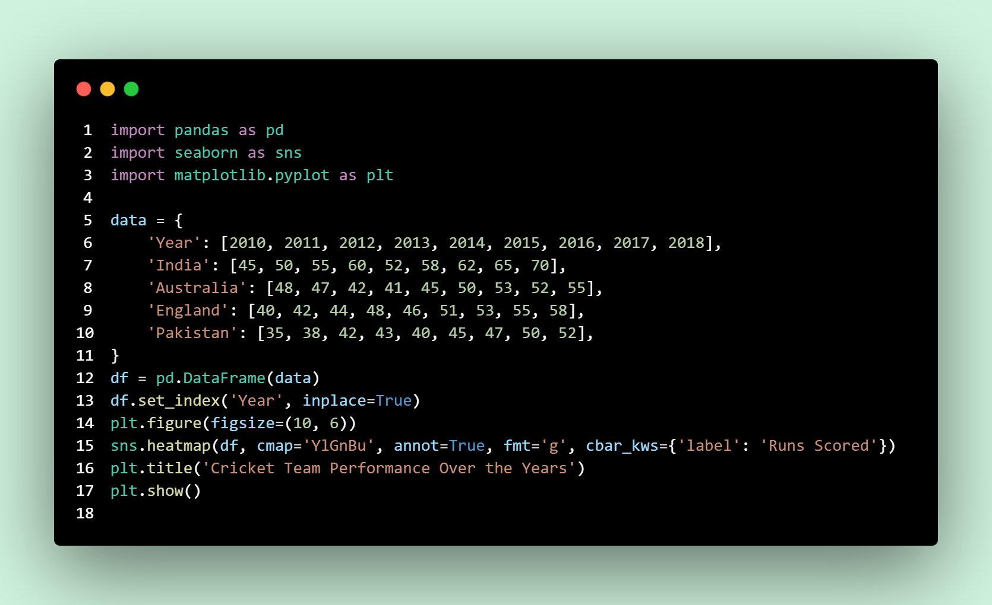
Using Heatmap visualize the performance of cricket teams over multiple years.

Slide 47
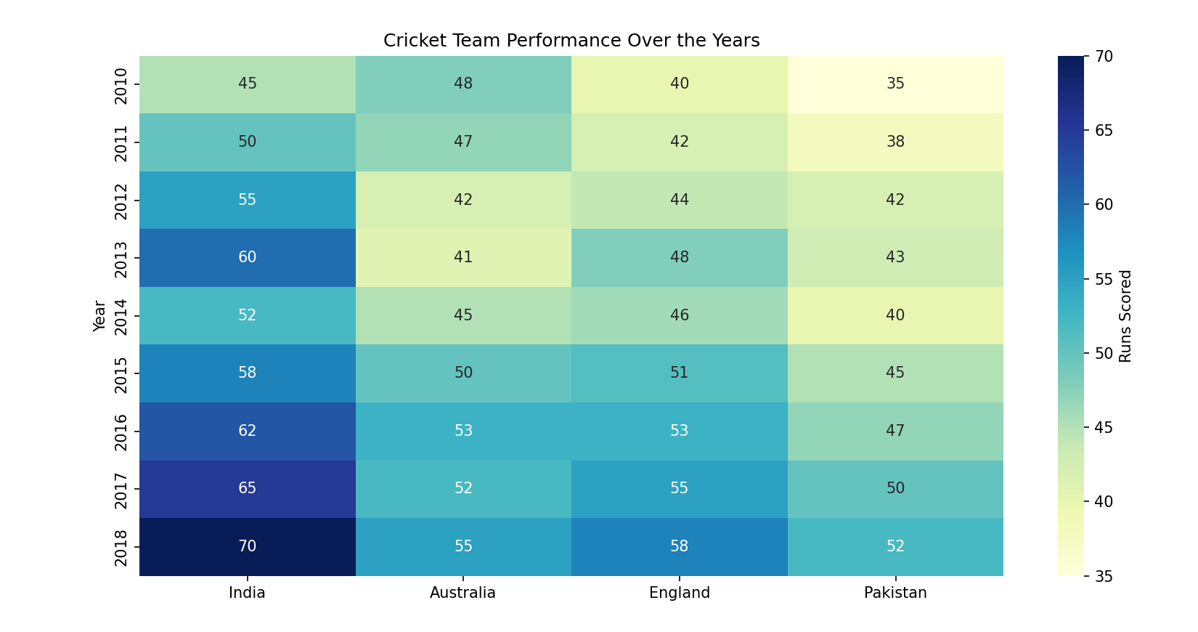

Slide 48
Map

Slide 49
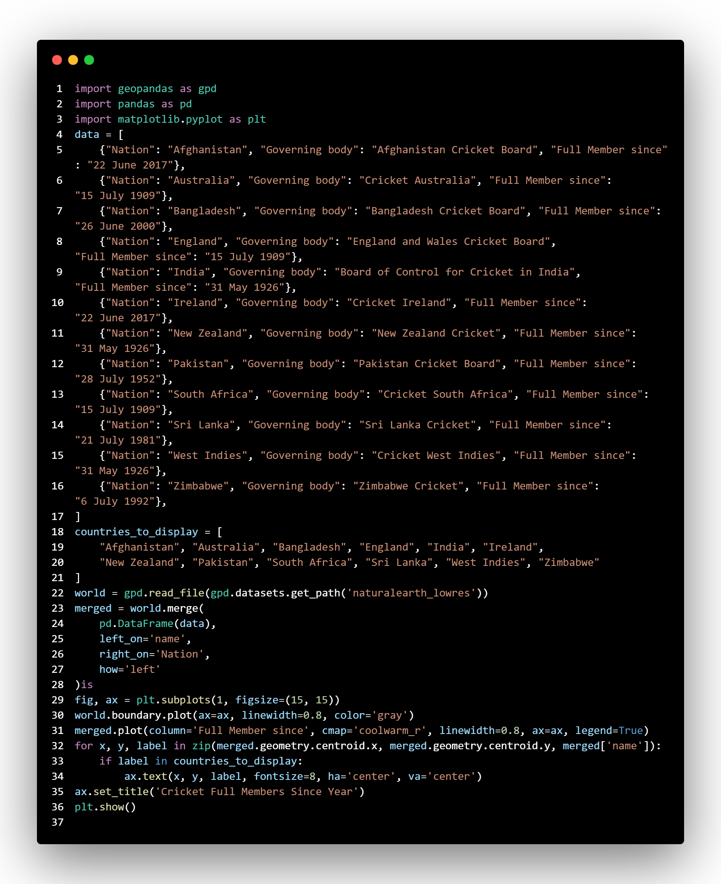
Map is created to visualize the full members of the International Cricket Council (ICC) and the year in which each country became a full member.

Slide 50
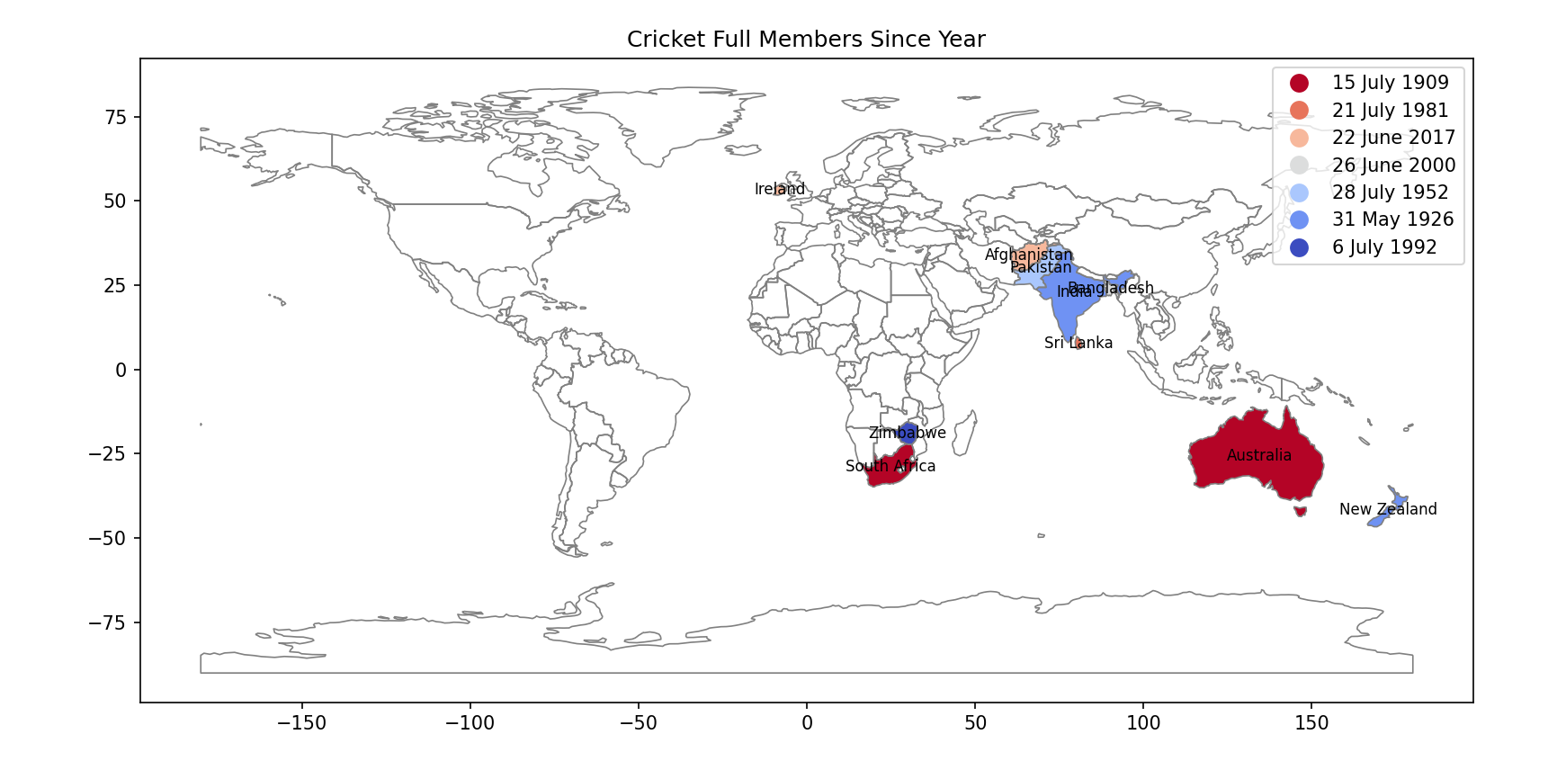

Slide 51
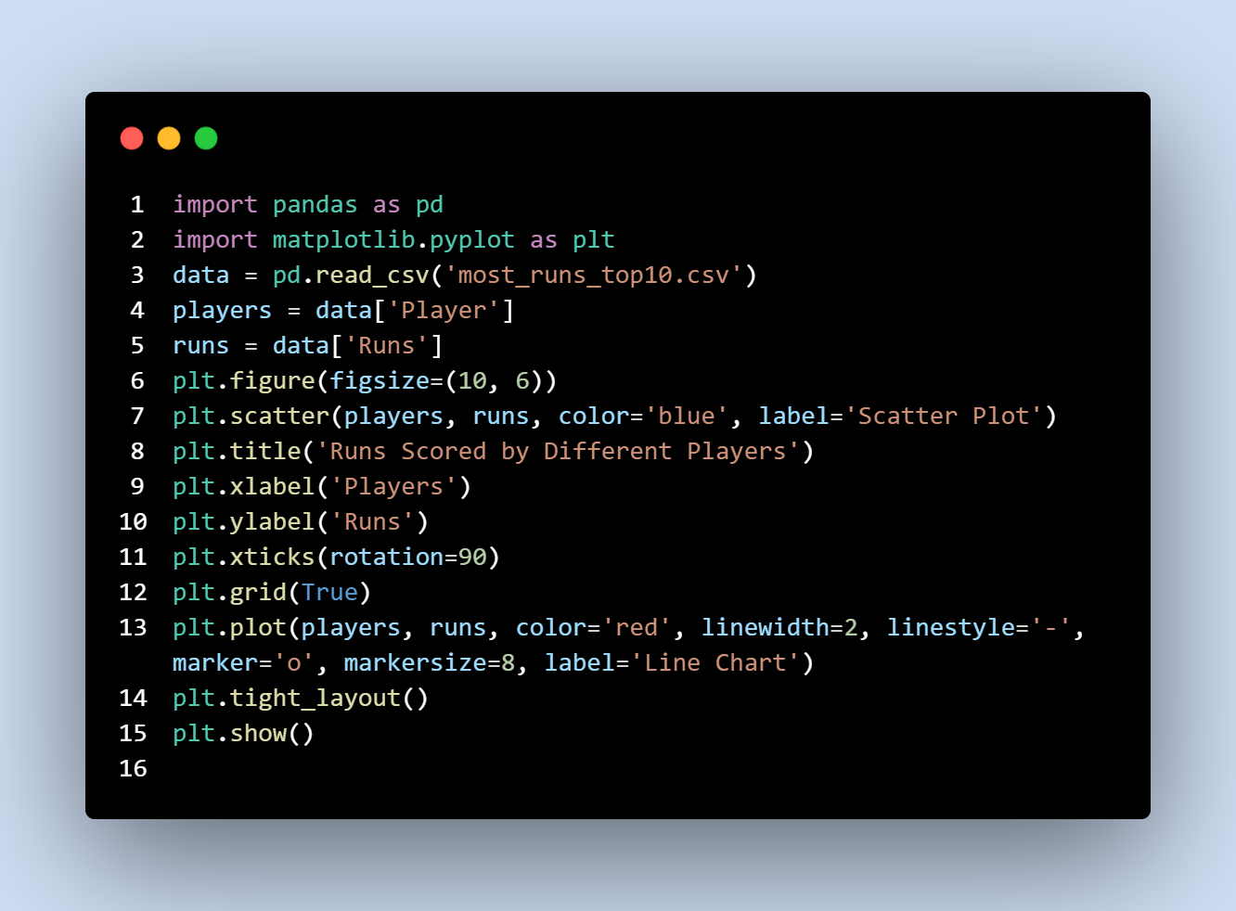
Program to show Line Chart Of top 10 Highest scorers in International Cricket !

Slide 52
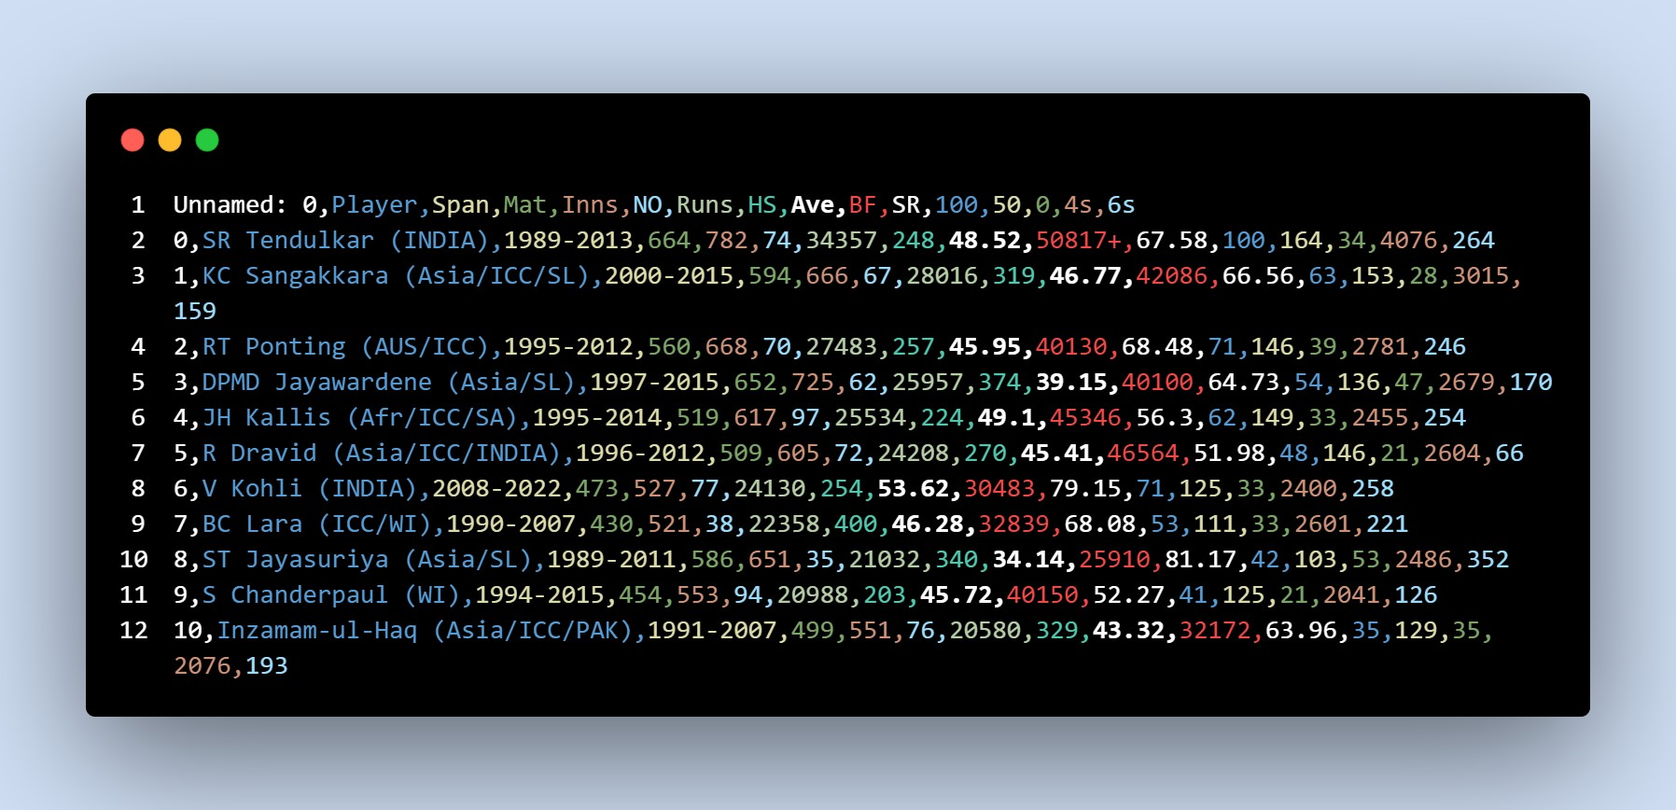

Slide 53
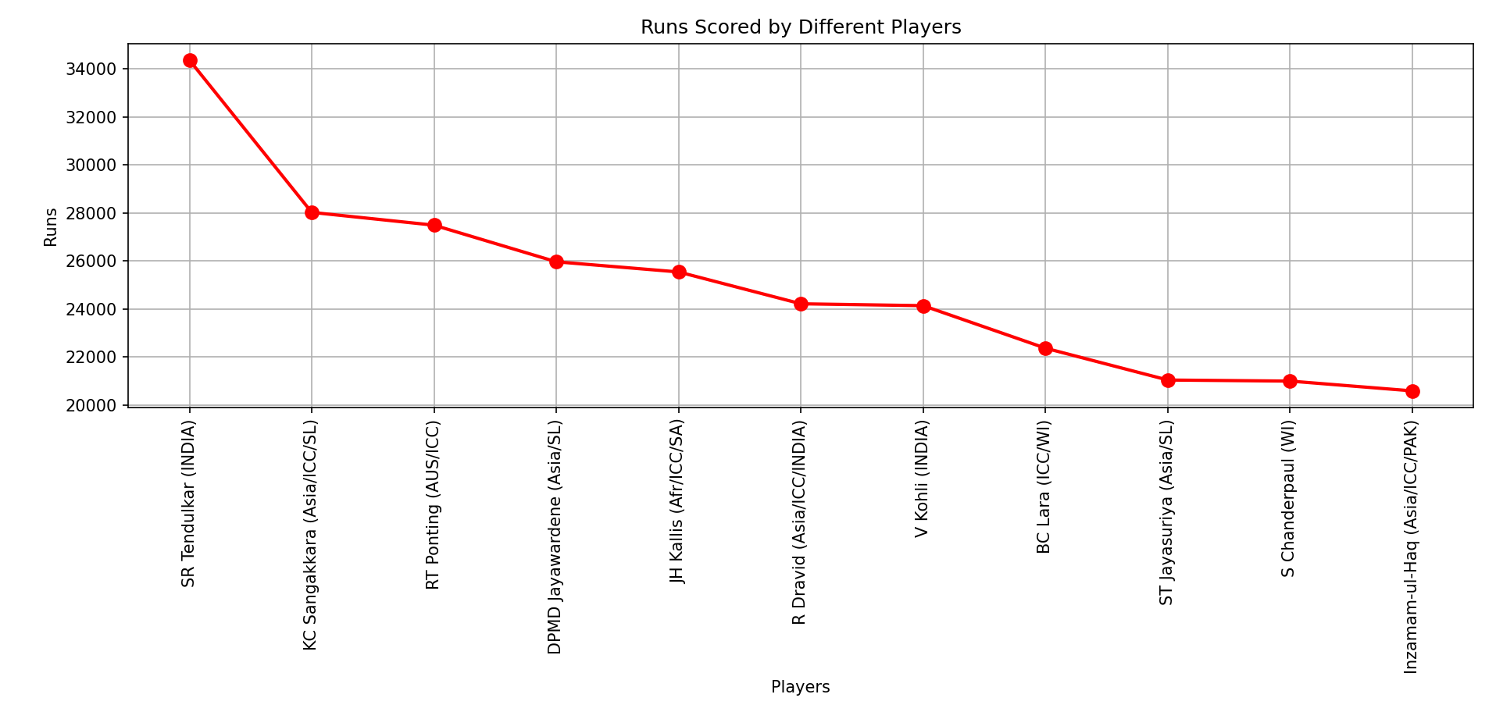

Slide 54
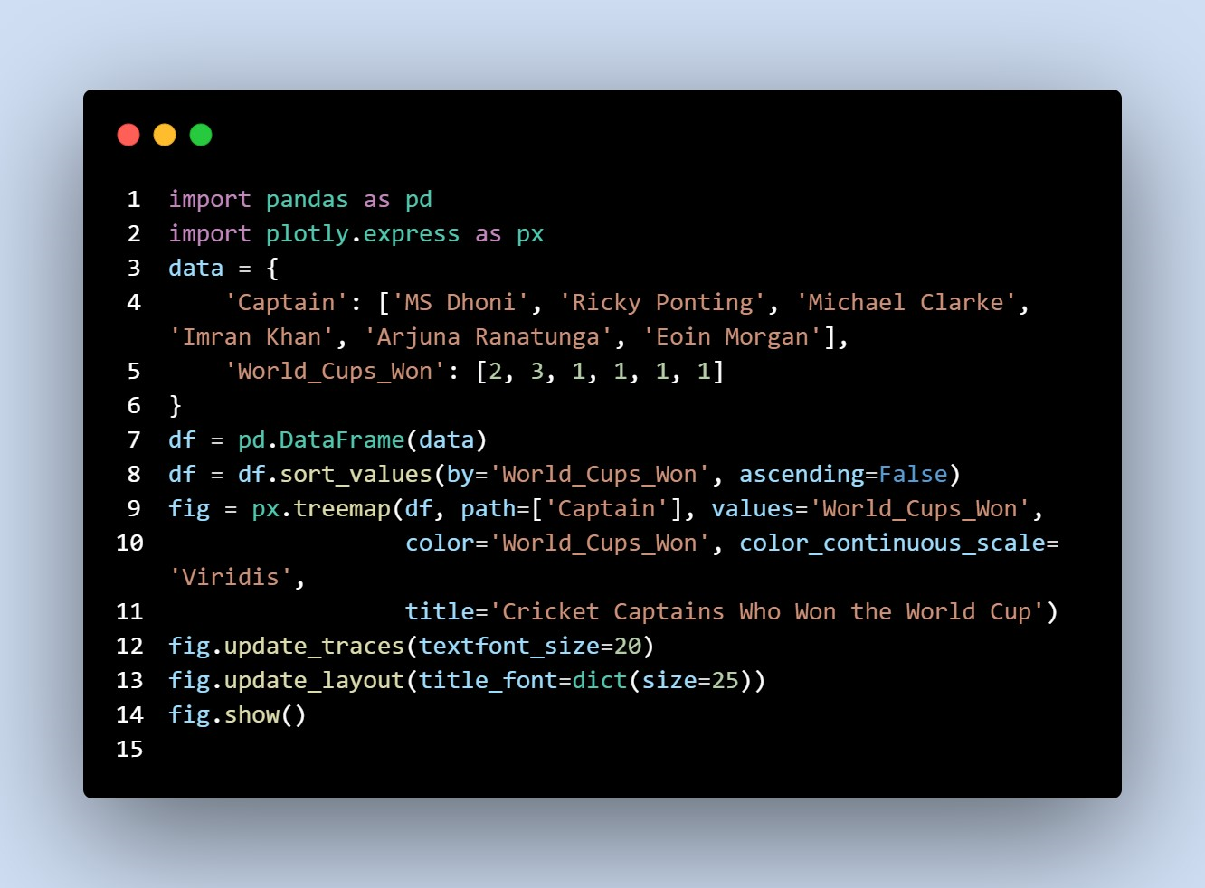

Slide 55
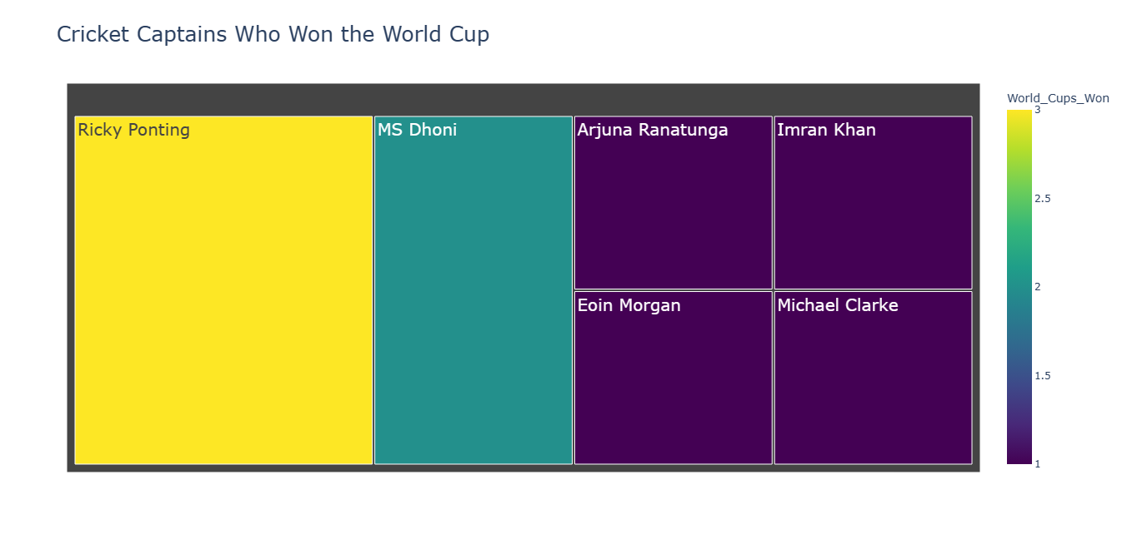

Slide 56
Box PLOT

Slide 57
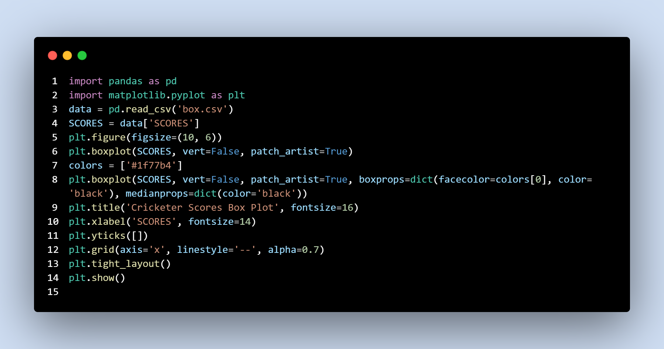

Slide 58
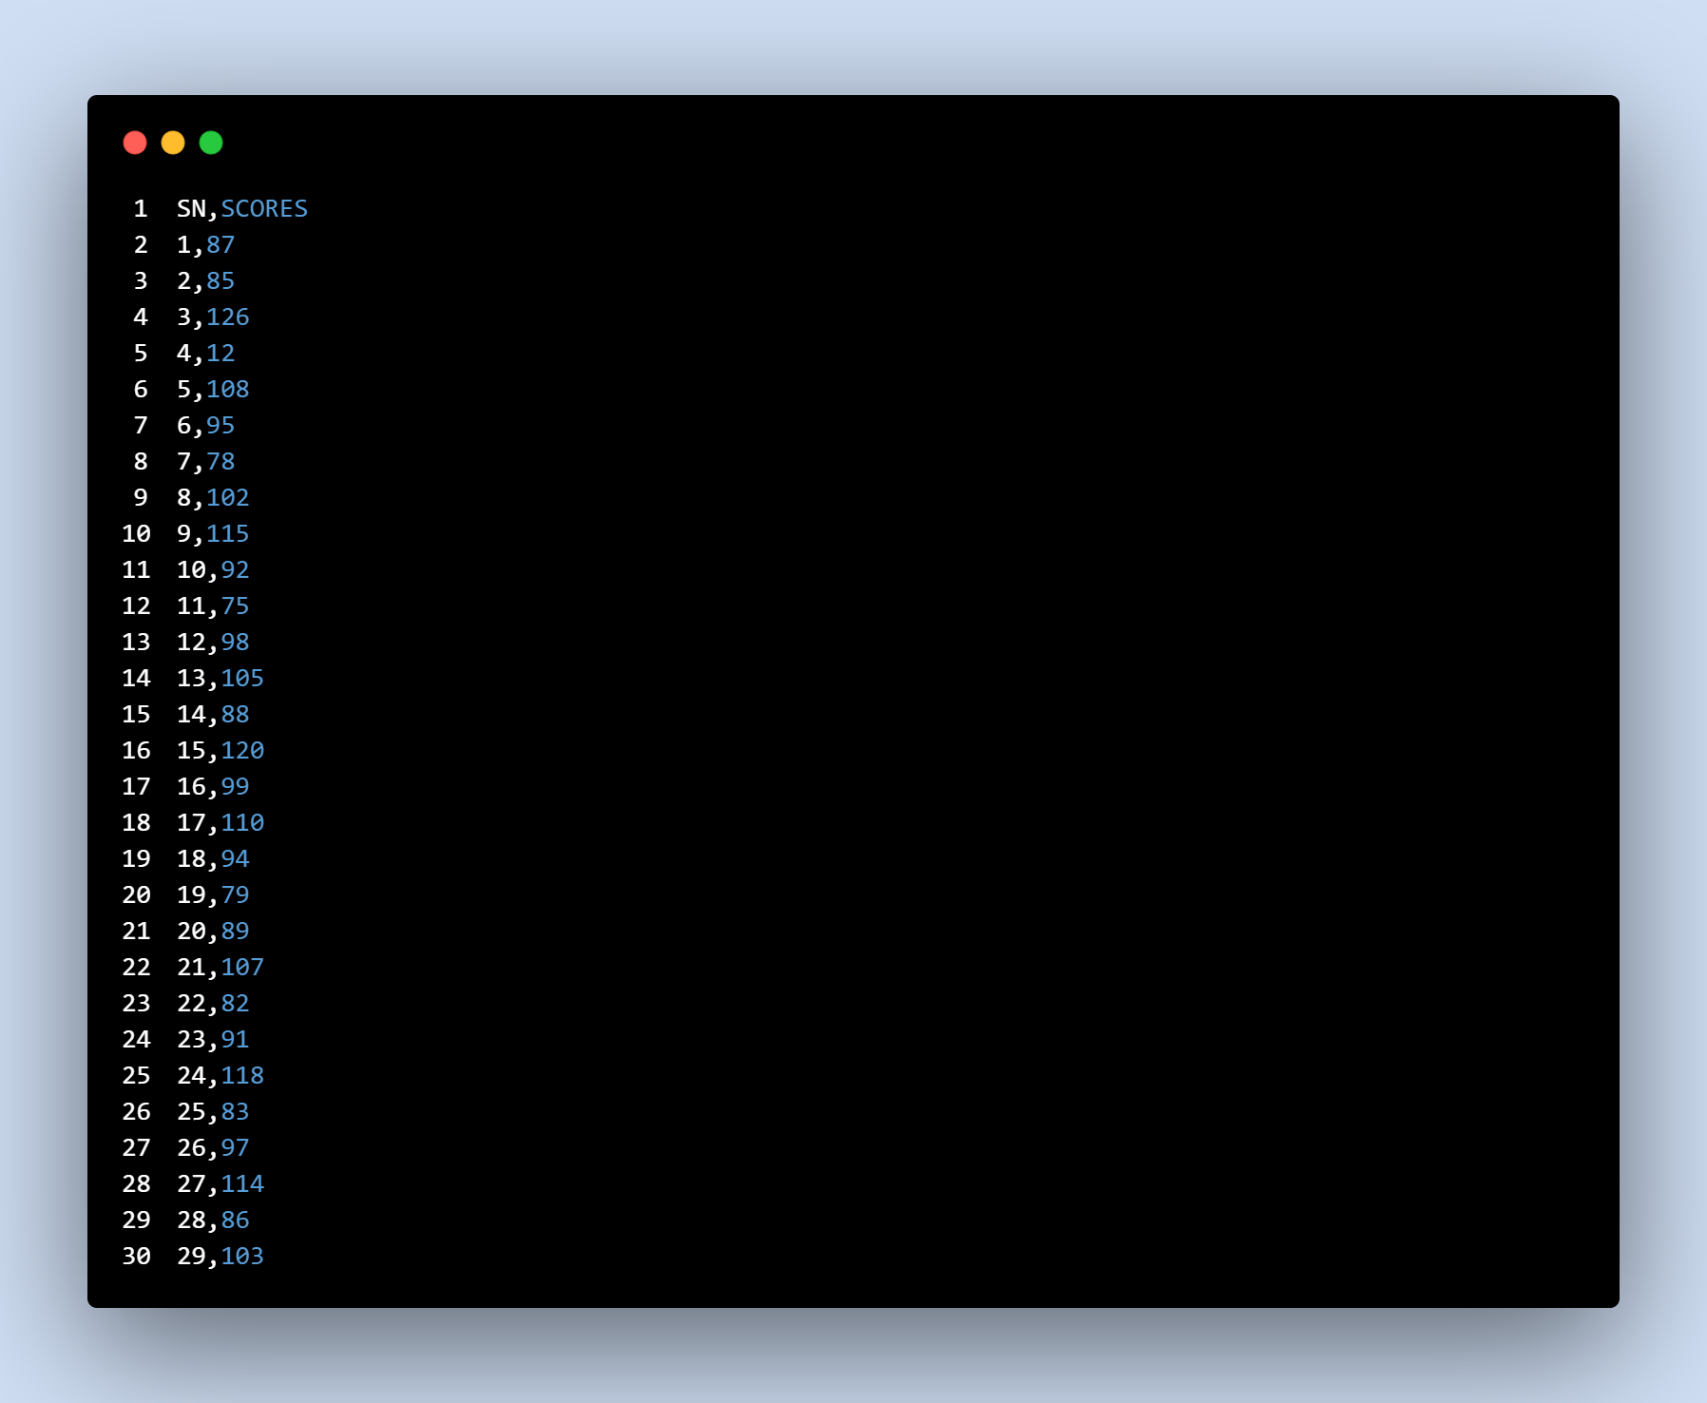

Slide 59
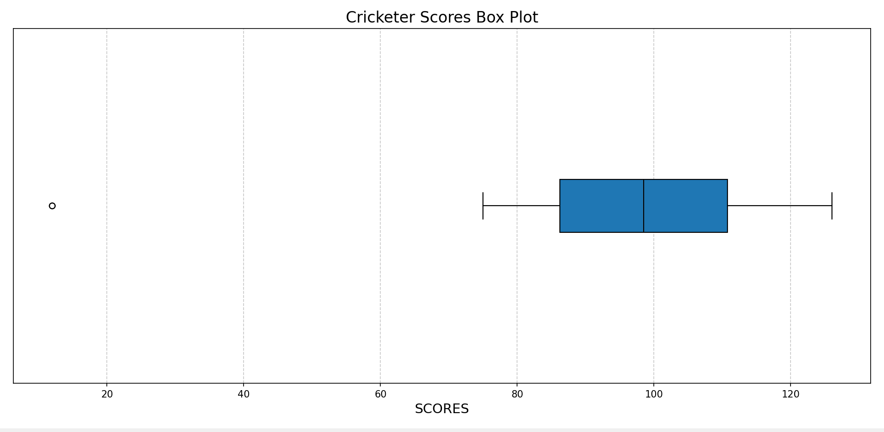

Slide 60
Visualization Website
https://top3-cricketer-ayush-harsh.netlify.app/

Slide 61
Some Screenshots of Website

Slide 62
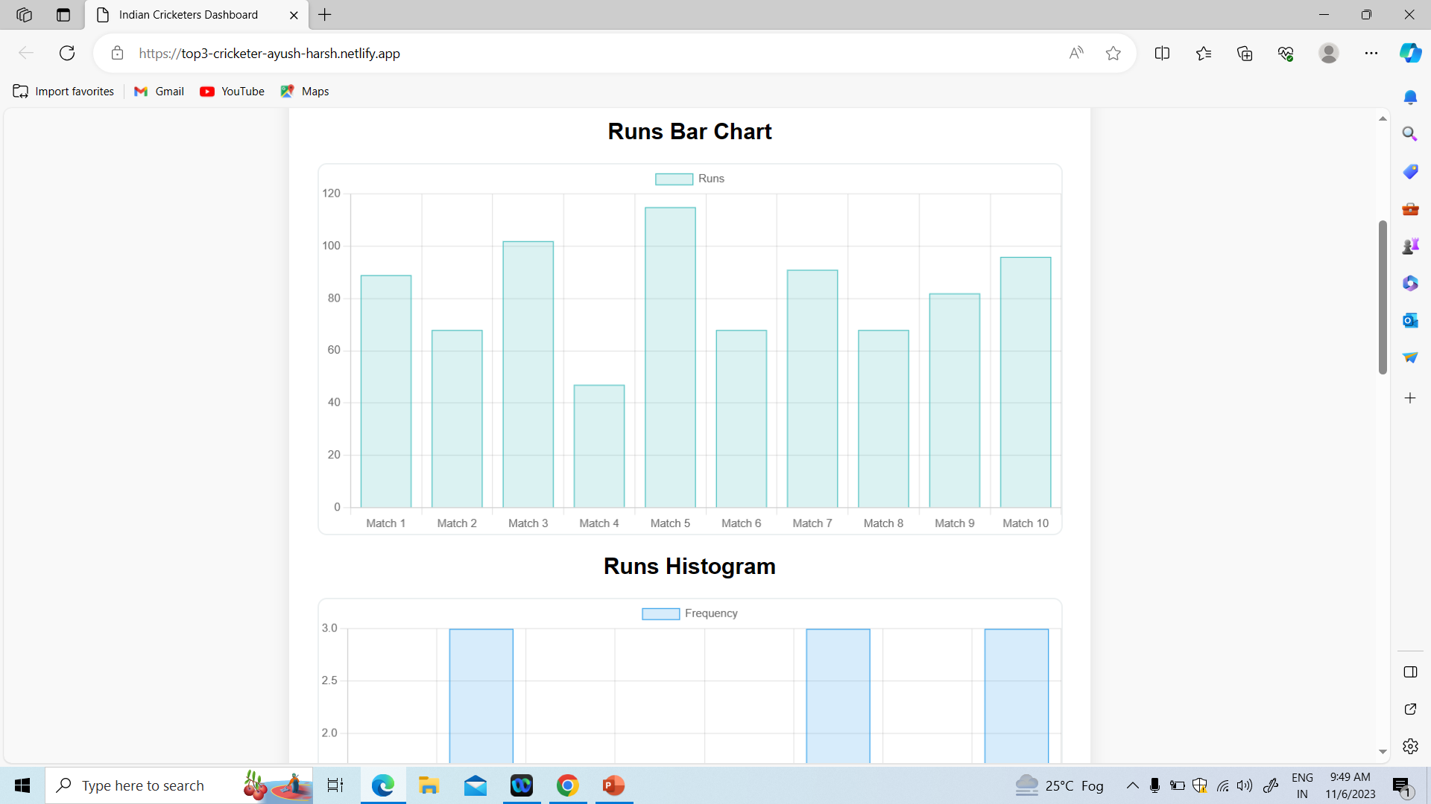

Slide 63
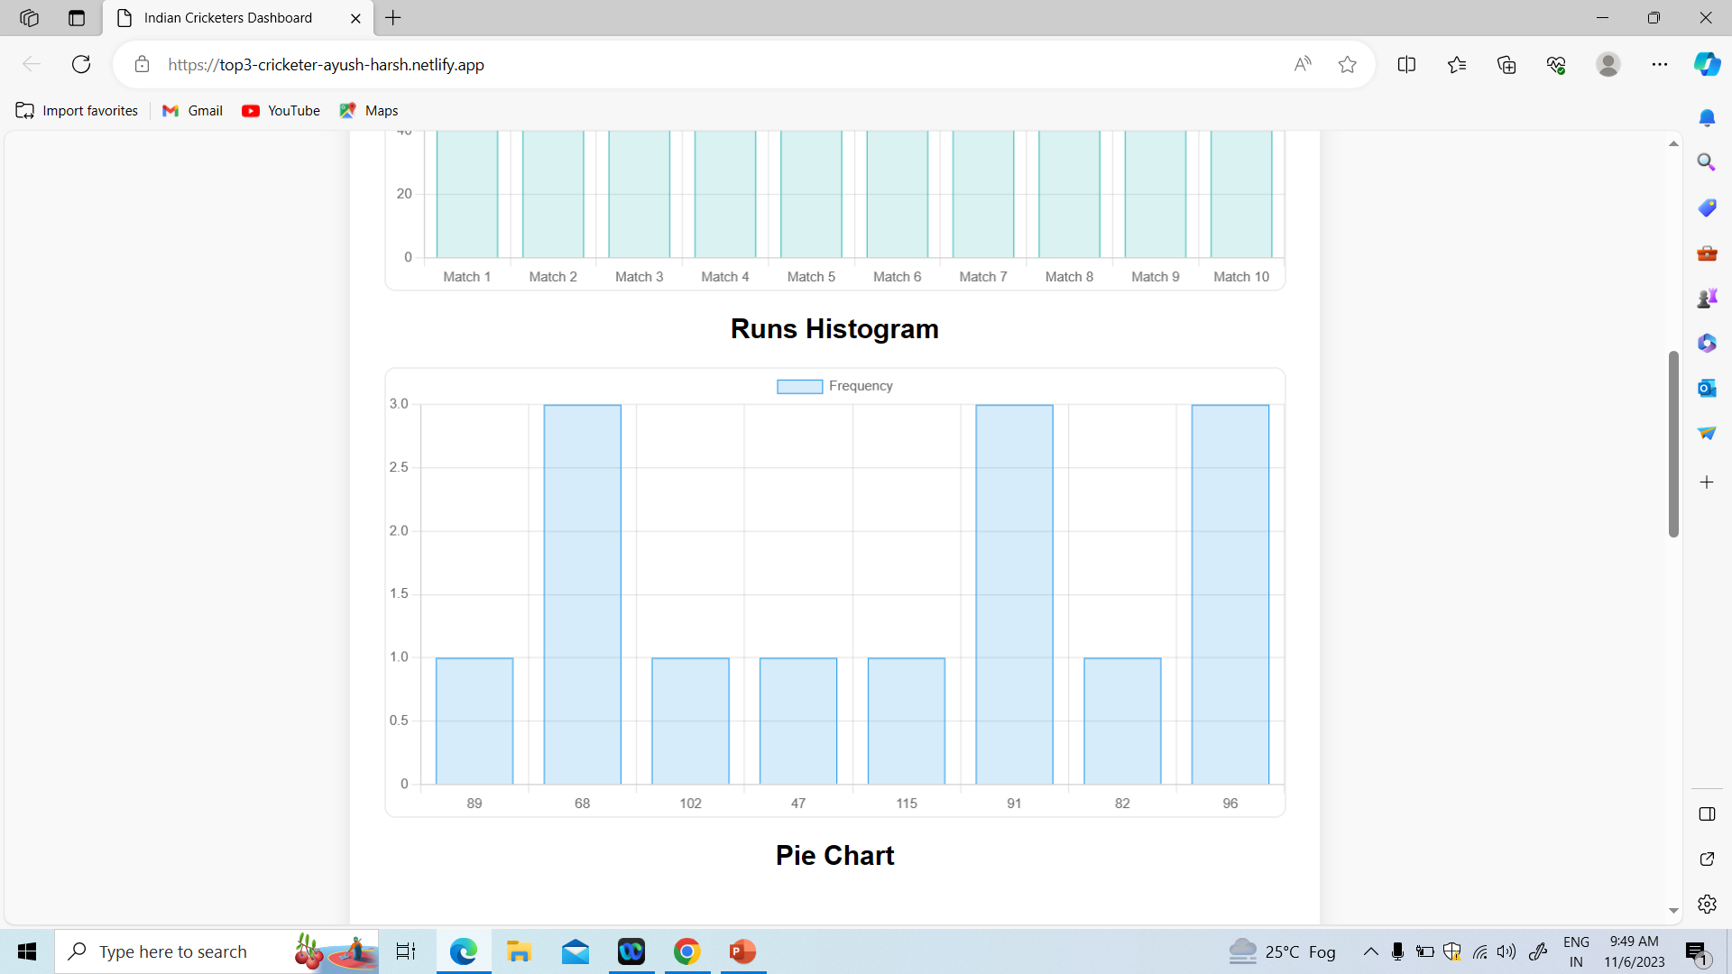

Slide 64
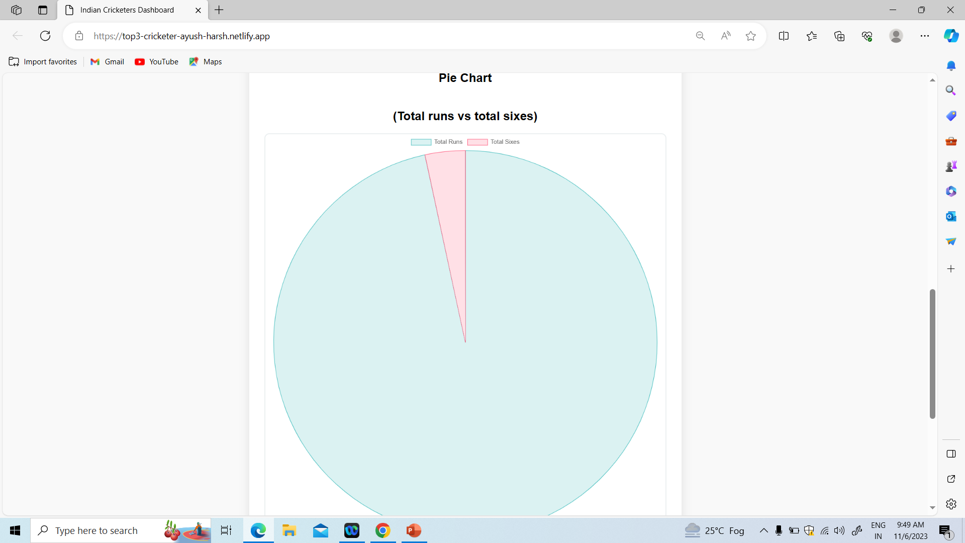
Visualization Using POWER BI

Slide 65
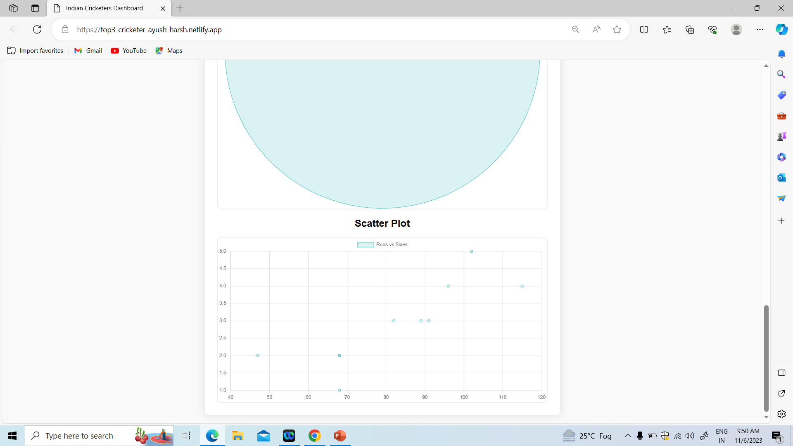
Visualization Using POWER BI

Slide 66
Visualization Using POWER BI

Slide 67
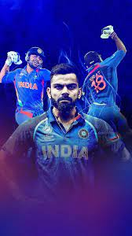
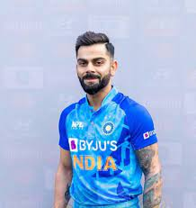
Analysis of Virat Kohli’s ODI career

Slide 68
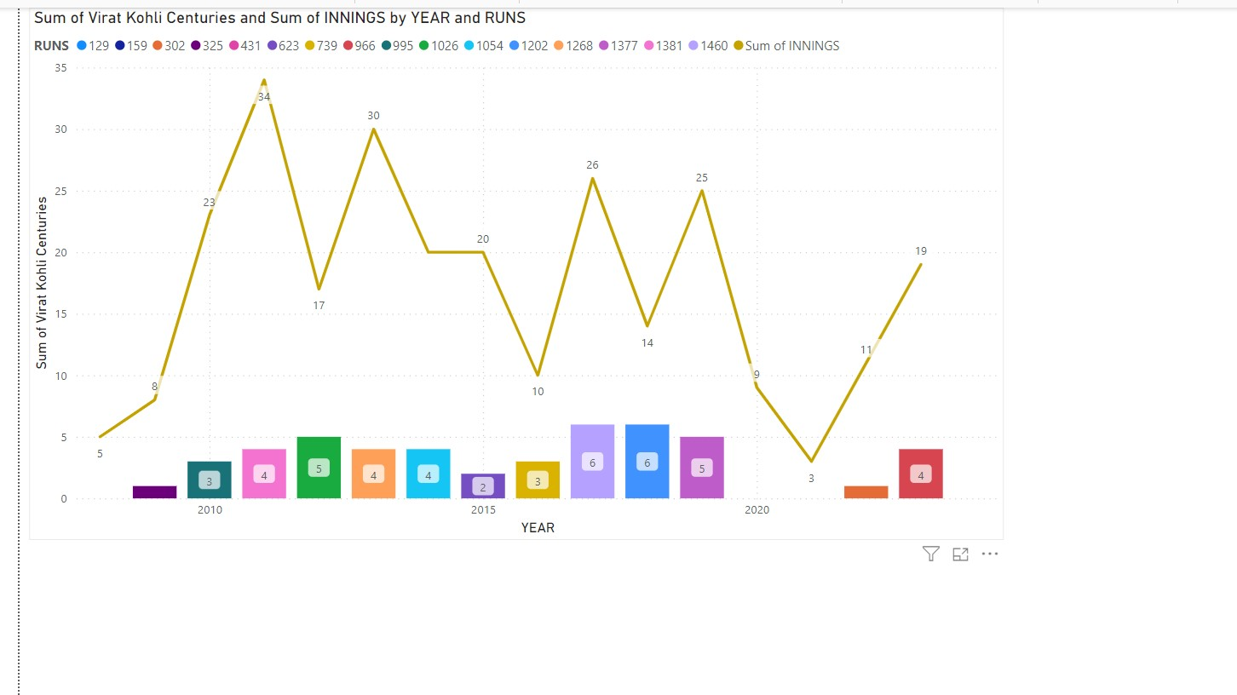
Line and Stacked Column Chart

Slide 69
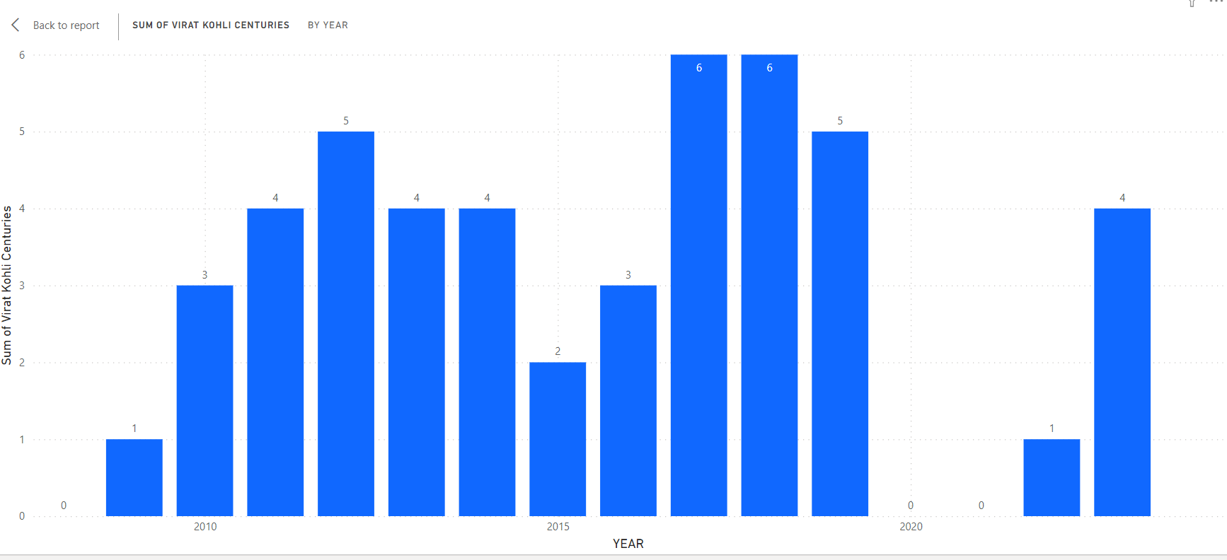
Virat Kohli Centuries using Bar Graph!

Slide 70
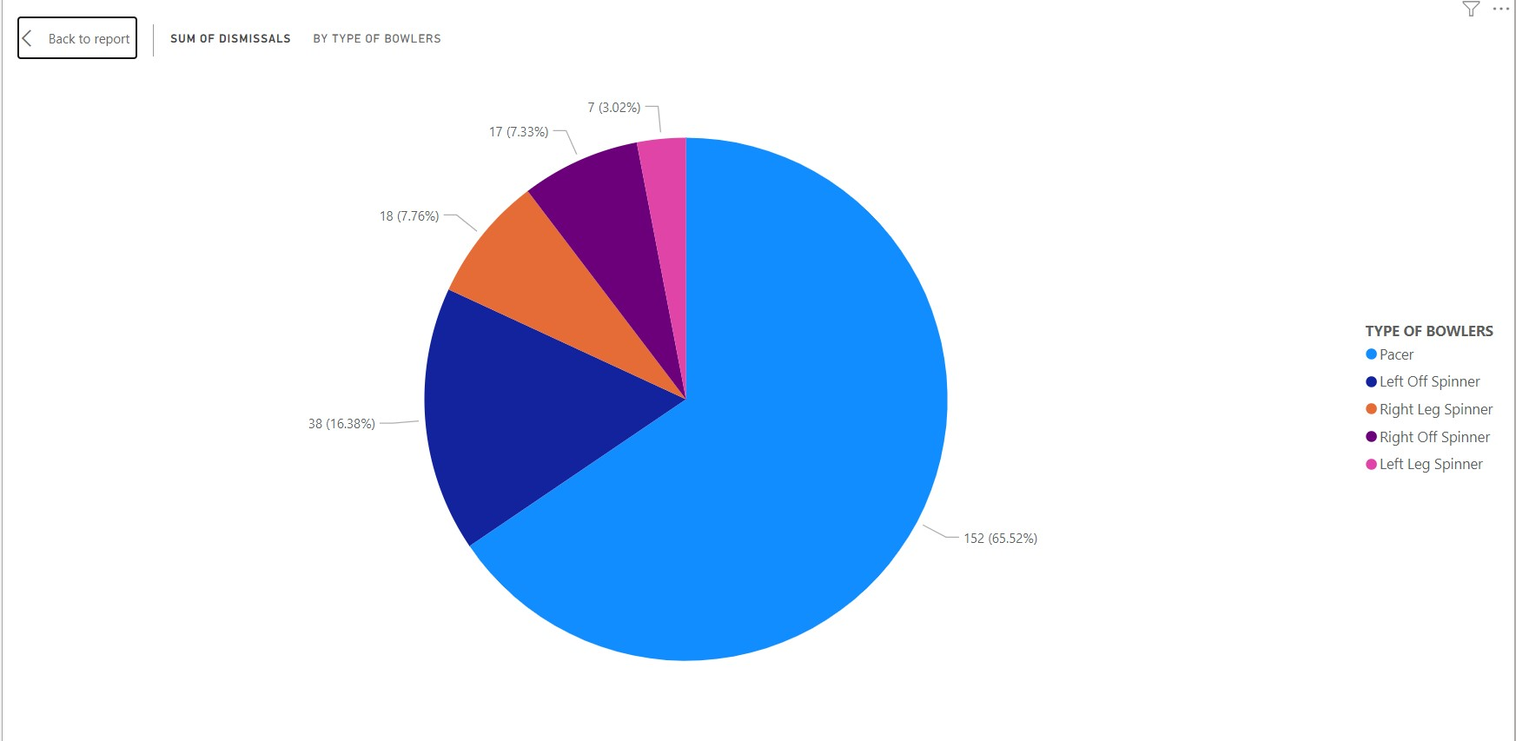
Virat Kohli Dismissal against different types of Bowlers using PIE Chart!

Slide 71
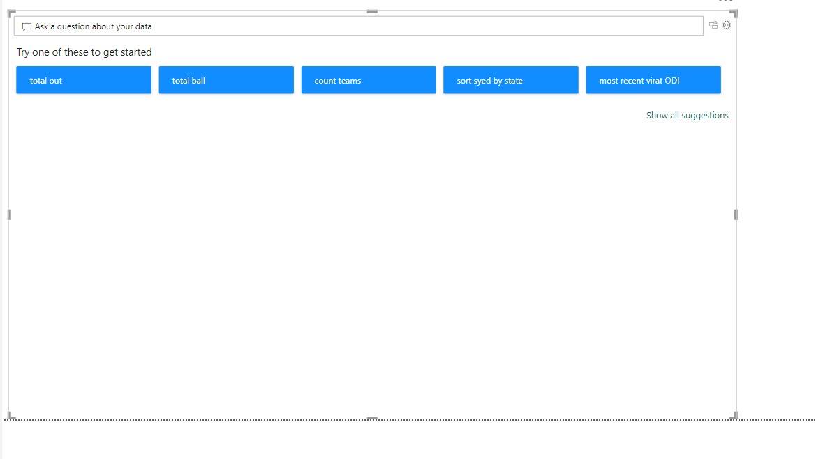
Q/A Visualization

Slide 72
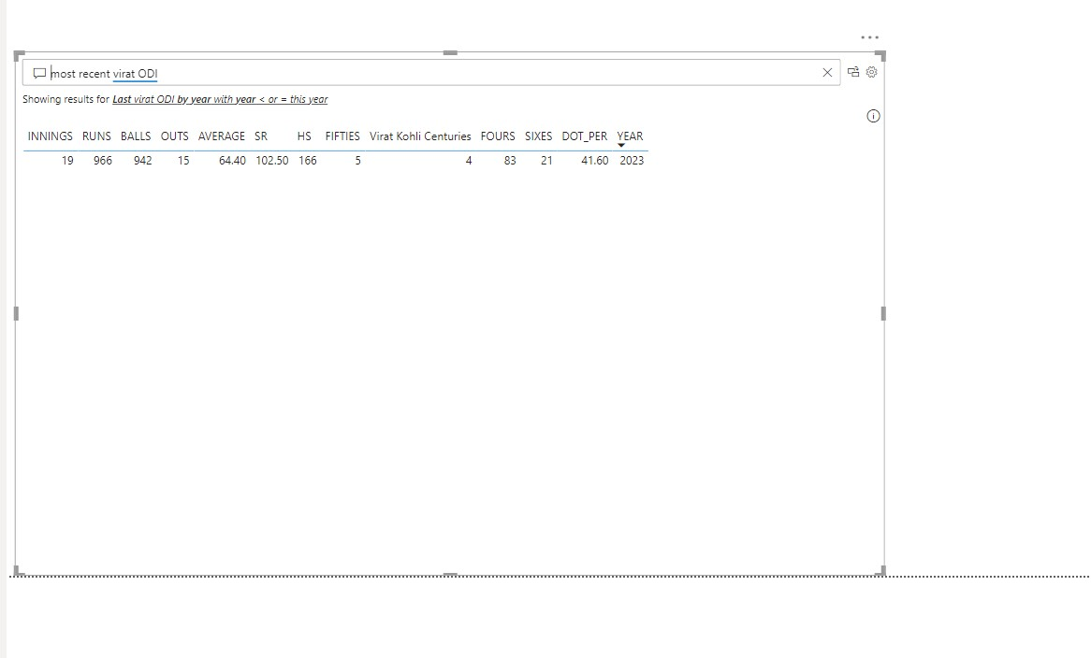

Slide 73
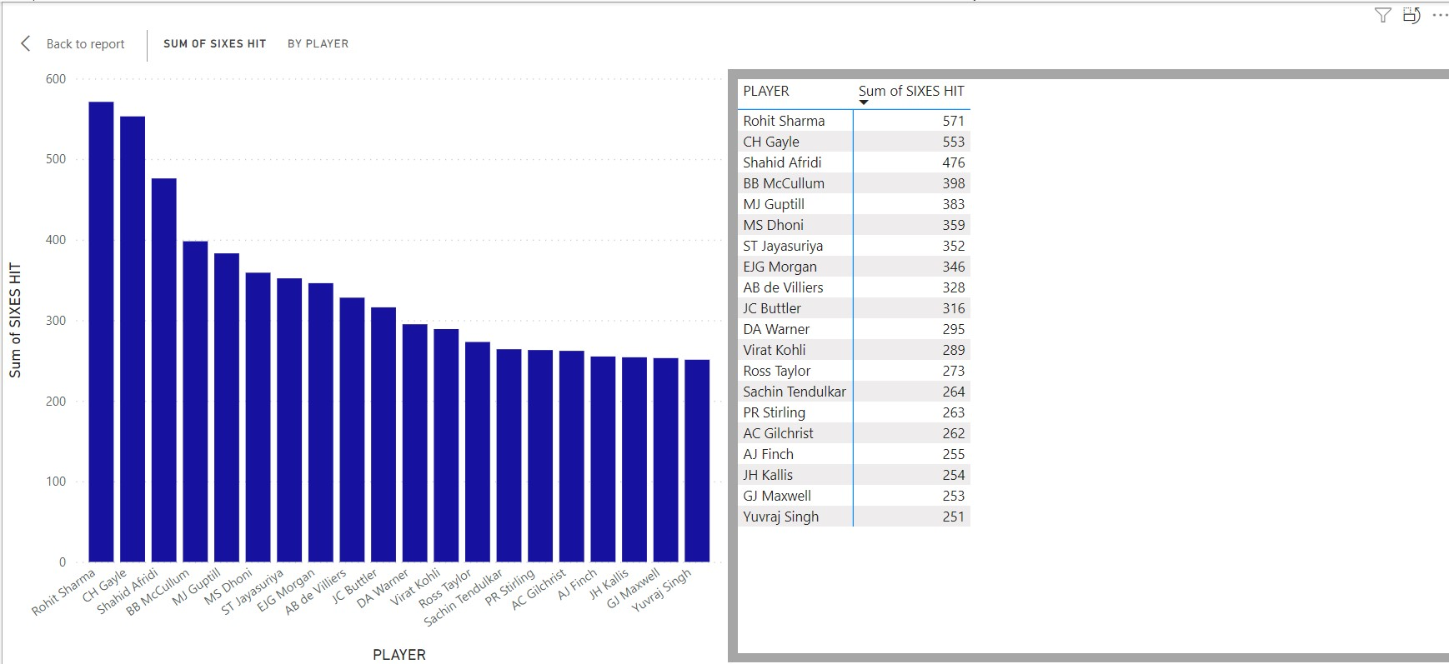
Six Hitters Of International Cricket Column Chart With Table

Slide 74
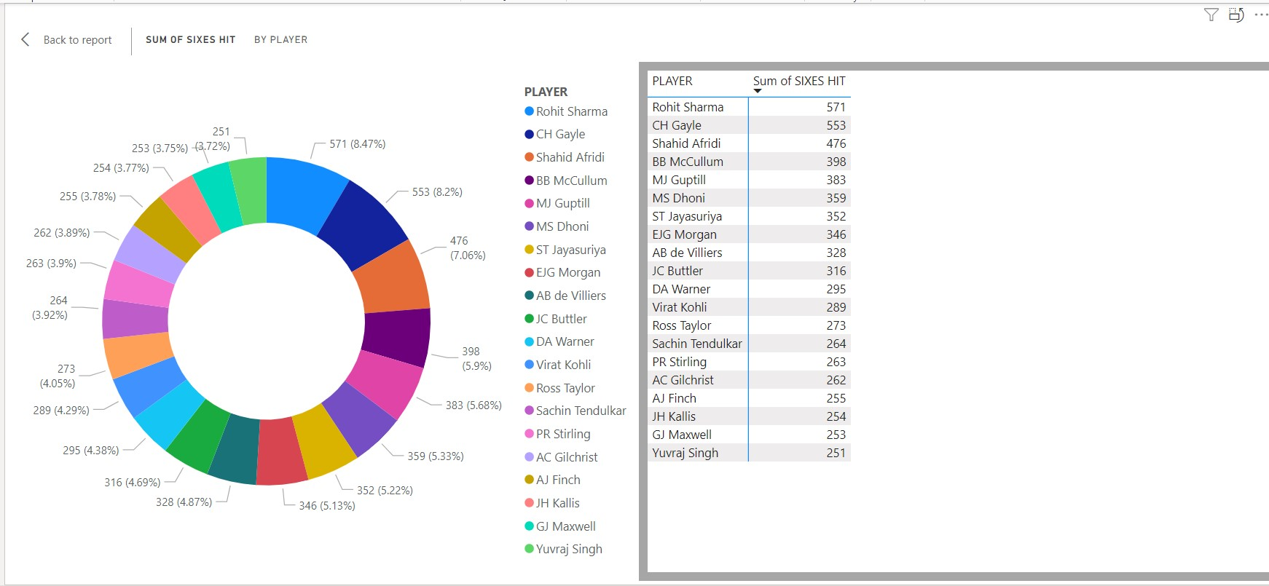
Six Hitters Of International Cricket Donut Chart With Table

Slide 75
2013 IND V/S AUS SERIES ANALYSIS

Slide 76


Slide 77

Area Chart of Top Run Scorers

Slide 78

Ribbon Chart of Top Run Scorers to discover highest Rank

Slide 79
INDIAN Domestic Trophies

Slide 80


The Ranji Trophy
Ranji Trophy: Premier domestic first-class cricket championship in India.Organized annually by the Board of Control for Cricket in India (BCCI)

Slide 81
Visualization Of Ranji Trophy Data

Slide 82

Showing Some Teams of Ranji Trophy On India Map

Slide 83

Donut Chart of Ranji Trophy Winners

Slide 84

Syed Mushtaq Ali Trophy
The Syed Mushtaq Ali Trophy is a domestic T20 cricket championship in India, organized by the Board of Control for Cricket in India (BCCI), among the teams from the Ranji Trophy

Slide 85

Syed Mushtaq Ali Trophy Winners Tree Map

Slide 86

Syed Mushtaq Ali Trophy Winners Pie Chart

Slide 87



INDIAN PREMIERE LEAGUE

Slide 88
The Indian Premier League (IPL) is a men's Twenty20 (T20) cricket league that is annually held in India and contested by ten city-based franchise teams The BCCI founded the league in 2007

Slide 89

INDIAN PREMIERE LEAGUE Winners Donut Chart

Slide 90

INDIAN PREMIERE LEAGUE Winners Tree Map

Slide 91

ORANGE CAP
The player who scores the most runs in the IPL is awarded the Orange Cap.

Slide 92

Donut Chart of Orange Cap Winners

Slide 93
Some Famous Innings Analysis

Slide 94


Rohit Sharma 264

Slide 95

Pie chart of Rohit Sharma’s Inning

Slide 96


Harmanpreet Kaur 171

Slide 97

Pie chart of Harmanpreet’s Inning

Slide 98

Each Ball Analysis of Harmanpreet’s Inning using Pie Chart

Slide 99
CONCLUSION
We have provide brief idea of Cricket -its history,rules,popularity,etc
We have made a website for proper understanding of Rules of Cricket.
https://icc-laws-of-cricket-ayush-harsh.netlify.app/
We have given information about governing of International Cricket.

Slide 100
We have take data from all formats of Cricket –Test,ODI,T20 for better analysis.
We have analysed both Women’s and Men’s Cricket.
We have made a Stats Calculator website to calculate stats(rates) in different formats of Cricket.
https://statscalculator-ayush-harsh.netlify.app/

Slide 101
We have used different Visualization techniques using Python and PowerBI and Visualized different data.
We have also dedicated a website on Visualization.
https://top3-cricketer-ayush-harsh.netlify.app/

Slide 102
Thus Following Aims Got Achieved:
Match Analysis
Great Cricketers Career Analysis-according to formats,their strengths,weakness,Scoring Areas.
Different International Competitions Analysis.
Different Indian Competitions Analysis.
Series Analysis
Famous Innings Analysis

Slide 103
Thank You!

